Slide 1

Transforming Medicaid’s
Addiction and Recovery Treatment Services Benefit
Dr. Katherine Neuhausen
Chief Medical Officer
Virginia Department of Medical Assistance Services
December 2016
http://www.dmas.virginia.gov

Slide 2
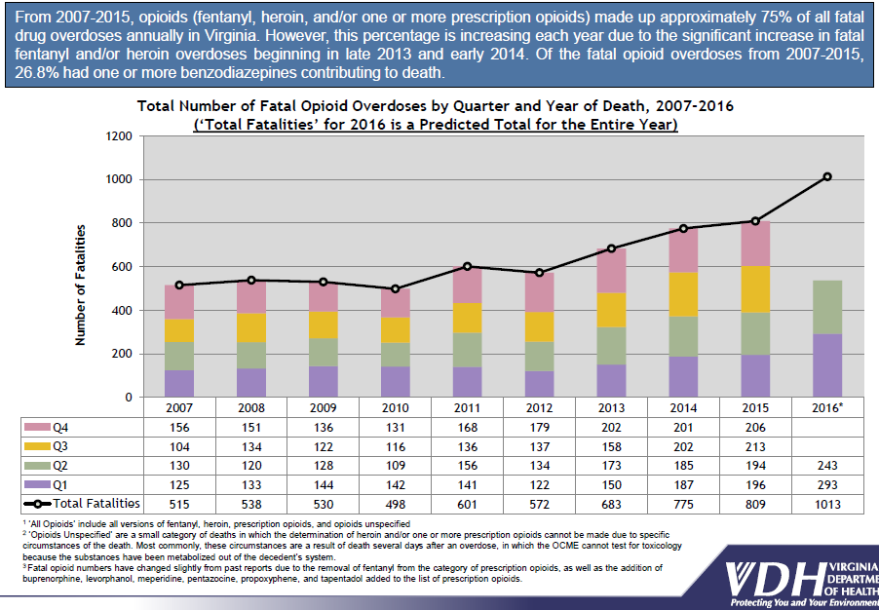
Scope of the Opioid Crisis in Virginia
Notes:
Virginia is experiencing a substance use crisis of overwhelming proportions. The human cost and financial impact of this epidemic are significant.
In 2013, the All Payer Claims Database showed Virginia’s Medicaid program spent $26 million on opioid abuse and misuse and an additional $28 million on Medicaid members diagnosed with Substance Use Disorder (SUD) who were treated by Emergency Departments.
The APCD reran this and provided an update that $44 million was spent on ED visits for Medicaid members diagnosed with a SUD in 2014.
DMAS identified 216,555 members with a claim that included a substance use disorder (SUD) diagnosis in state fiscal year 2015.

Slide 3
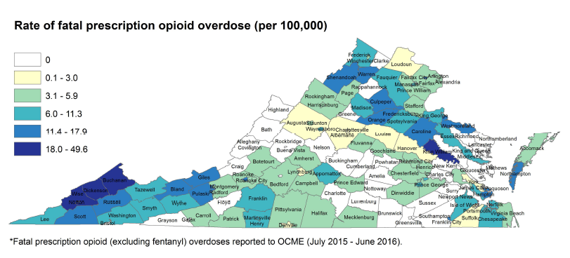
Prescription Opioid Fatal Overdoses 2015-2016
Notes:
Virginia is experiencing a substance use crisis of overwhelming proportions. The human cost and financial impact of this epidemic are significant.
In 2013, the All Payer Claims Database showed Virginia’s Medicaid program spent $26 million on opioid abuse and misuse and an additional $28 million on Medicaid members diagnosed with Substance Use Disorder (SUD) who were treated by Emergency Departments.
The APCD reran this and provided an update that $44 million was spent on ED visits for Medicaid members diagnosed with a SUD in 2014.
DMAS identified 216,555 members with a claim that included a substance use disorder (SUD) diagnosis in state fiscal year 2015.

Slide 4
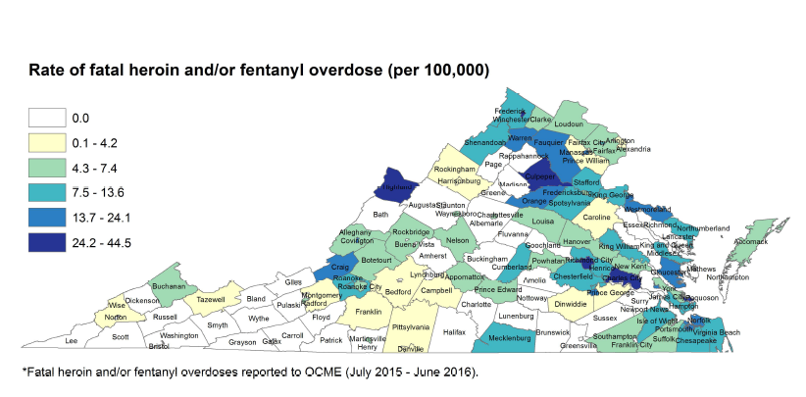
Heroin/Fentanyl Fatal Overdoses 2015-2016
Notes:
Virginia is experiencing a substance use crisis of overwhelming proportions. The human cost and financial impact of this epidemic are significant.
In 2013, the All Payer Claims Database showed Virginia’s Medicaid program spent $26 million on opioid abuse and misuse and an additional $28 million on Medicaid members diagnosed with Substance Use Disorder (SUD) who were treated by Emergency Departments.
The APCD reran this and provided an update that $44 million was spent on ED visits for Medicaid members diagnosed with a SUD in 2014.
DMAS identified 216,555 members with a claim that included a substance use disorder (SUD) diagnosis in state fiscal year 2015.

Slide 5
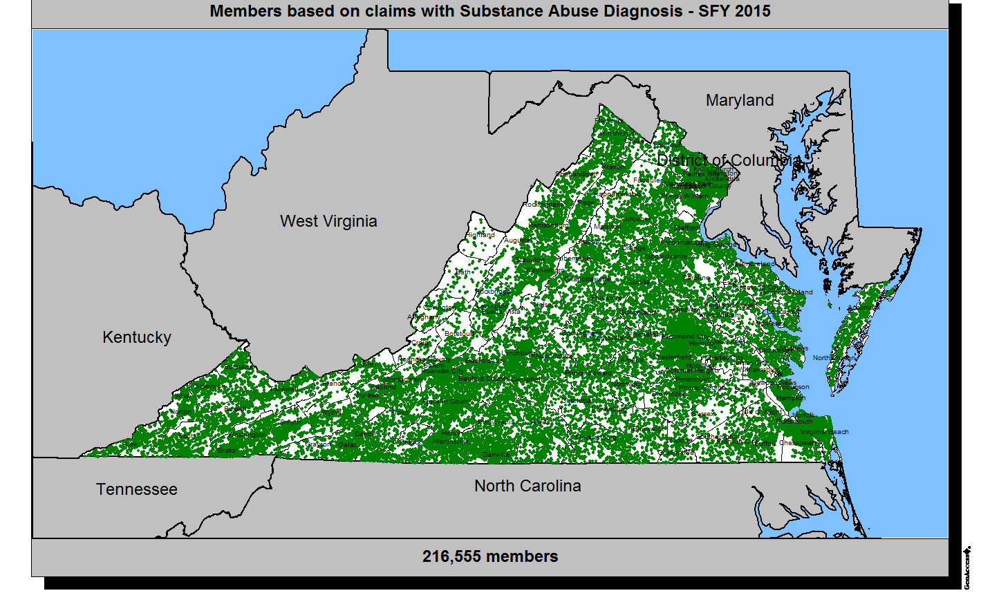
Locations of Members Enrolled in Medicaid with SUD Diagnosis
Notes:
Virginia is experiencing a substance use crisis of overwhelming proportions. The human cost and financial impact of this epidemic are significant.
In 2013, the All Payer Claims Database showed Virginia’s Medicaid program spent $26 million on opioid abuse and misuse and an additional $28 million on Medicaid members diagnosed with Substance Use Disorder (SUD) who were treated by Emergency Departments.
The APCD reran this and provided an update that $44 million was spent on ED visits for Medicaid members diagnosed with a SUD in 2014.
DMAS identified 216,555 members with a claim that included a substance use disorder (SUD) diagnosis in state fiscal year 2015.

Slide 6
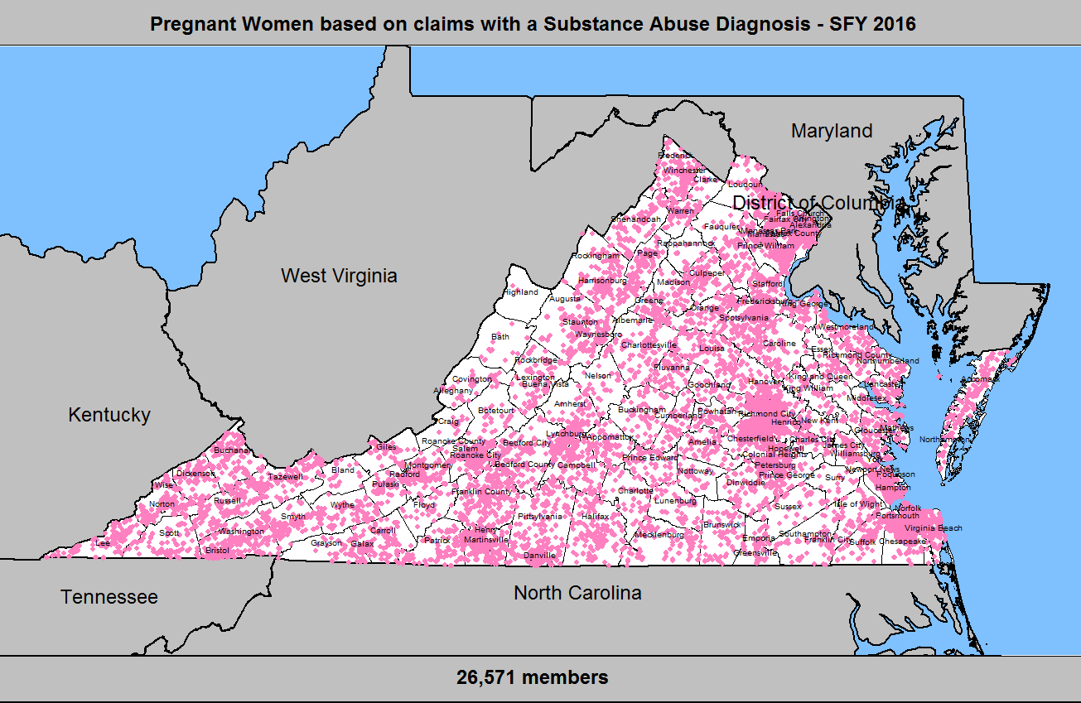
Location of Pregnant Women enrolled in Medicaid with a SUD Diagnosis
Notes:
Close to 27,000 women enrolled in Medicaid and who are pregnant had a substance use diagnosis in SFY 2016.
Of major concern are the babies who are born exposed to opioids. Of the nearly 1,000 babies born with Neonatal Abstinence Syndrome, last year, 80% are enrolled in Medicaid.

Slide 7
March 2016: SUD benefit passed in GA budget
April – August 2016: Workgroup designed SUD benefit → renamed ARTS benefit
August 2016: DMAS submitted ARTS waiver to CMS
April 1, 2017: ARTS benefit implemented statewide
July 1, 2017:
Peer supports for substance use and mental health conditions implemented statewide
Comprehensive SUD/ARTS benefit included in the budget passed by General Assembly in March 2016

Slide 8
Addiction and Recovery Treatment Services (ARTS) Benefit
Changes to DMAS’s Substance Use Disorder (SUD) Services
for Medicaid and FAMIS Members
1
Expand short-term SUD inpatient detox to all Medicaid /FAMIS members
2
Expand short-term SUD residential treatment to all Medicaid members
3
Increase rates for existing Medicaid/FAMIS SUD treatment services
4
Add Peer Support services for individuals with SUD and/or mental health conditions
5
Require SUD Care Coordinators at DMAS contracted Managed Care Plans
6
Provide Provider Education, Training, and Recruitment Activities
Notes:
The Medicaid covered substance use disorder program is changing in response to the Governor and Virginia General Assembly passing this benefit in response to the opioid crisis.
These are the six major components of the changes to the SUD benefits.

Slide 9
Reforming the Current Delivery System for Community-Based Services
ARTS
Residential Treatment
Partial Hospitalization
Intensive Outpatient Programs
Case Management
Opioid Treatment
Crisis Intervention
Inpatient Detox
Peer Recovery Supports
Magellan will continue to cover community-based substance use disorder treatment services for fee-for-service members
All Community-Based SUD Services will be Covered by Managed Care Plans
A fully integrated Physical and Behavioral Health Continuum of Care
Effective April 1, 2017
Addiction and Recovery Treatment Services (ARTS)
Peer Recovery Supports effective July 1, 2017
Notes:
In 2015 close to 70% of members were served in managed care. With the implementation of MLTSS, this will close to 90% served in managed care.
To fully integrate physical and behavioral health services for individuals with SUD and expand access to the full continuum of services, DMAS plans to “carve in” non-traditional SUD services into Managed Care for members who are already enrolled in plans. The only service currently covered by managed care is inpatient detoxification.
Non-traditional services that will be “carved in” include Residential Treatment, Opioid Treatment (medication and counseling component), Substance Abuse Day Treatment, Crisis Intervention, Intensive Outpatient Treatment, and Substance Abuse Case Management.
Magellan will continue to cover these services for those Medicaid members who are enrolled in FFS
Effective April 1, 2017 except for Peer Supports which will be effective July 1, 2017.
Providers will need to become enrolled and credentialed with the managed care plans beginning 4/1/17. Majority of members are covered by managed care and most when the Managed Long Term Services and Supports (MLTSS) is implemented.

Slide 10
Medicaid and FAMIS Coverage for Individuals with SUD
SUD Service | Children < 21 | Adults* | Pregnant Women
Traditional Services
Inpatient Detox | X | Added | Added
Outpatient Therapy | X | X | X
Medication Assisted Treatment (MAT) | X | X | X
Community-Based Services
Residential** | Rate Increase | Added | Rate Increase
Partial Hospitalization | Rate Increase | Rate Increase | Rate Increase
Intensive Outpatient | Rate Increase | Rate Increase | Rate Increase
MAT | Rate Increase | Rate Increase | Rate Increase
Crisis Intervention | X | X | X
Case Management / Care Coordination | Rate Increase | Rate Increase | Rate Increase
Peer Supports | Not Covered | Added | Added
*Dual eligible individuals have coverage for inpatient and residential treatment services through Medicare. **DMAS seeking to waive the CMS IMD ruling which limits coverage for RTC to facilities with 16 beds or fewer. Note: FAMIS and GAP coverage does not include residential treatment. GAP does not cover Inpatient Services or PHP.
Services Highlighted in Yellow were added by the 2016 Appropriations Act
Notes:
Services Highlighted in Yellow are newly added services.
Virginia spent $1.7 million on SUD in FY 2015. SUD spending in FY 2015 was less than 1% of the total FFS BH spending ($789 million). Part of this reason of low utilization are the low rates. Majority of services are getting a rate increase, many up to 400%.
FAMIS and GAP coverage does not include residential treatment.
GAP does not cover Inpatient Services or PHP.

Slide 11
Medicaid 1115 Demonstration Waiver
Medicaid 1115 Demonstration waiver submitted on August 5 to Centers for Medicare and Medicaid Services to:
    Allow federal matching Medicaid dollars for services provided in an IMD, which is currently prohibited for mental health or SUD treatment delivered in facilities with > 16 beds
    Allow Virginia Medicaid to pay for services provided in residential treatment facilities > 16 beds, significantly increasing SUD treatment capacity
Waiver would NOT change who is eligible for treatment services
Waiver would require Medicaid health plans and providers to use American Society of Addiction Medicine (ASAM) criteria in all substance use assessment and treatment services
Notes:
All services for the current 1.1 million enrolled members. This is not changing criteria for member eligibility.

Slide 12
DMAS Addiction and Recovery Treatment Services
Overview of ASAM Levels of Care
Notes:
Switching gears to cover ASAM levels of care and rate structure.

Slide 13
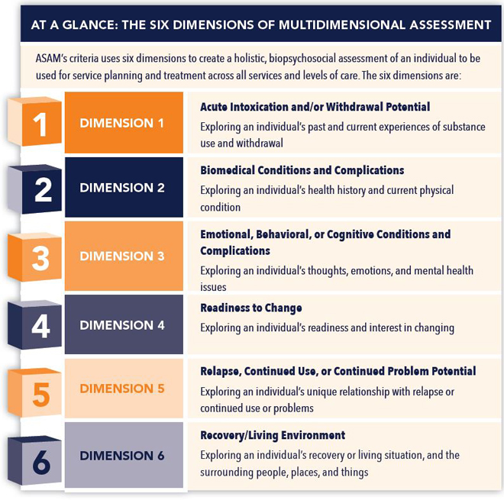
ASAM Assessment
Criteria
Notes:
ASAM uses a multidimensional biopsychosocial assessment to guide service planning and treatment in all levels of care. These six dimensions represent different life areas that together impact the assessment, service delivery and level of care placement decisions.
The six dimensions provide common language of holistic, biopsychosocial assessment and treatment across addiction treatment, mental health, physician health, mental health and incorporates spiritual issues in the recovery process.
Indicates what types and intensity of withdrawal management services are needed.
Indicates placement decisions to move to higher care with increased staffing to manage co-occurring psychiatric needs or to manage physical health complications
Indicates placement in co-occurring capable or co-occurring enhanced programs also may indicate placement into a higher level of care to allow for more staff supervision and opportunities for counseling to address emotional status.
Indicates the person may need extra structure and to remain in higher level of care or to be ready to attempt less structured settings to implement new choice patterns and to engage in less programmatic structure in their recovery.
Co-occurring issues and relapse prevention issues indicate the continued placement in more structured programs until the individual has the coping mechanisms to manage triggers, impulsivity anger or other issues that may lead to relapse. The status of the individual indicates the need for a higher level of care or progression to try lower levels of care. Movement through the levels should be dynamic, risk can be managed and options for failure can be experienced with strategies in place.
Safe living environment where peers and families do not use substances vs living in environment surrounded with substance users or others that enable use. The recovery environment again, indicates the level of care that is needed to ensure the patient has the skills needed to cope with his or her environment.

Slide 14
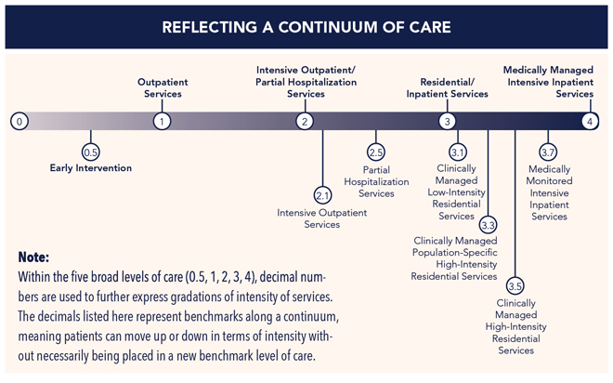
ASAM Continuum of Care
Notes:
Main Levels of Care
1. Outpatient Counseling
2. Intensive Outpatient, Partial Hospitalization and WM
3. Residential Treatment continuum from medical model RTC/Inpatient Psych facility (3.7) to halfway house/group home (3.1)
4. Medically Managed Hospital Level of Care
CMS is requiring an independent agent to complete the assessment for placement in RTC. MCOs and Magellan care coordinators will be the independent agent to review the provider assessment and request for residential treatment.
Individuals have individualized treatment plan to receive person centered care and can transition between levels depending on their need.

Slide 15
ASAM WM / LOC / DBHDS License Crosswalk
ASAM LOC Placement | ASAM Level of WM | DBHDS License
4 Medically Managed Intensive Inpatient | 4-WM Medically Managed Intensive Inpatient Withdrawal Management | Acute Care General Hospital (12VAC5-410)
3.7 Medically Monitored Intensive Inpatient Services (Adult) Medically Monitored High-Intensity Inpatient Services (Adolescent) | 3.7-WM Medically Monitored Inpatient Withdrawal Management | Inpatient Psychiatric Unit Acute Freestanding Psychiatric Hospital Substance Abuse (SA) Residential Treatment Service (RTS) for Adults/Children Residential Crisis Stabilization Unit Medical Detox License required for all
3.5 Clinically Managed High-Intensity Residential Services (Adults) / Medium Intensity (Adolescent) 3.3 Clinically Managed Population-Specific High-Intensity Residential Services (Adults) | 3.2-WM Clinically Managed Residential Withdrawal Management | Inpatient Psychiatric Unit (3.5) )/Required for co-occurring enhanced programs SA RTS for Adults (3.3 or 3.5) and Children (3.5) SA and MH RTS for Adults and Children (3.3 or 3.5)/Required for co-occurring enhanced programs Supervised RTS for Adults (3.3) Medical Detox License required for 3.2 WM
3.1 Clinically Managed Low-Intensity Residential Services | n/a | MH & SA Group Home Service for Adults and Children (Required for co-occurring enhanced programs) SA Halfway House for Adults
2.5 Partial Hospitalization Services 2.1 Intensive Outpatient Services | 2-WM Ambulatory Withdrawal Management w/ Extended On-site Monitoring | SA or SA/Mental Health Partial Hospitalization (2.5) SA Intensive Outpatient for Adults, Children and Adolescents (2.1) Outpatient Managed Withdrawal Service Licensed required for 2WM
1 Outpatient Services | 1-WM Ambulatory Withdrawal Management w/o Extended On-site Monitoring | Outpatient Services
0.5 Early Intervention | 0.5 Early Intervention | N/A; All Licensed Providers
Opioid Treatment Program (OTP) | OTP | Opioid Treatment Program
Office-Based Opioid Treatment (OBOT) | OBOT | N/A; Physician Offices
Notes:
Providers not only need to meet the DBHDS licensing requirements, but also ensure that the ASAM criteria for placement is being applied appropriately.

Slide 16
DMAS Addiction and Recovery Treatment Services
Medication Assisted Treatment (MAT) for Opioid Use Disorder

Slide 17
Medication Assisted Treatment
Definition and Evidence
ARTS Benefit Supports Comprehensive MAT
The use of medications in combination with counseling and behavioral therapies for the treatment of substance use disorders.
Use of MAT for opioid use disorder leads to successful recovery rates of 40-60%, compared to 5-20% with abstinence-only models
Increases rates for opioid treatment - the counseling component of MAT
Allows OTPs and OBOT providers to bill for care coordination and peers
MAT can be provided by:
Opioid Treatment Providers (OTPs) – CSBs and private providers licensed by DBHDS
Office-Based Opioid Treatment (OBOT) providers – primary care clinics, FQHCs, outpatient psychiatry clinics, other physician offices, etc.
Allows providers to bill separately for opioid treatment when members are receiving treatment in ASAM levels 1, 2.1, 2.5, 3.1, and 3.5.
Notes:
MAT is a foundational services for addiction treatment.
Equivalent as insulin is to diabetes.
Care Coordination and Peer Services are newly reimbursable.
VDH Addiction Disease Management trainings being offered to assist providers in MAT and successful reimbursement.

Slide 18
Medications Available for Medication Assisted Therapy for all SUDs
Medication | Service Authorization Required | Availability (Opioid Treatment Program (OTP), Pharmacy (Rx), Physician Administered Drug (PAD)
Buprenorphine/Naloxone and Buprenorphine | Induction (7 days) – no Maintenance - yes | OTP, Rx, PAD
Methadone | No (for opioid use disorder) | OTP, Rx, PAD
Naltrexone Long-Acting Injection | No | OTP, Rx, PAD
Naltrexone (oral) | No | OTP, Rx, PAD
Naloxone | No | OTP, Rx, PAD
Disulfiram | No | OTP, Rx, PAD
Acamprosate | No | OTP, Rx, PAD
Notes:
Initial prior authorization is not required for these medications exempt for Methadone.
Only buprenorphine containing drugs will need prior auth during maintenance period.
Methadone SA not required in OTP.

Slide 19
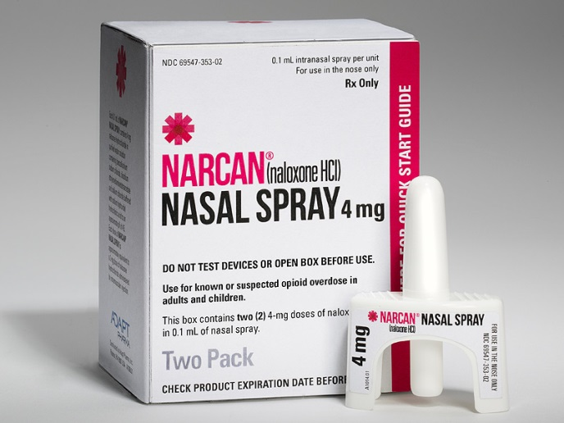

Opioid Overdose Fatality Prevention
Prior Authorization not required for
Increase Access to Naloxone
Naloxone injection
Naloxone (Narcan®)nasal spray
FFS and Managed Care Plans Expand Naloxone Coverage

Slide 20
Payment Model for Office-Based Opioid Treatment Providers
Service Description | Codes
Physician Visit | H0014 MAT Induction CPT E/M Code: Established Patient
Counseling | H0020 Opioid Treatment - individual, group counseling and family therapy / prescribing and medication oversight
Care Coordination | G9012 Substance Abuse Care Coordination
Peer Supports | H0038 Peer Support Services S9445 Peer Patient Education – Individual S9446 Peer Patient Education - Group
Urine Drug Screen | G0477-G0483
Labs | Examples: Hepatitis B Test (86704), Hepatitis C test (86803), HIV Test (86703), Pregnancy Test (81025), Skin Test-Tuberculin (86585)
Notes:
Group counseling code and rate is being determined. Considering 90853 with HF modifier.

Slide 21
Opioid Treatment
Service Description
Assessment of psychosocial needs
Supportive individual and/or group counseling
Linkages to existing family support systems
Referrals to community-based services
Provider Requirements
Provider Types for Psychosocial Treatment
Medication Administration/Oversight AND
Care coordination, medical/prescription monitoring, and coordination of on-site and off-site treatment services
Induction phase of MAT must be provided by Registered Nurse.
Maintenance phase of MAT may be provided by Licensed Practical Nurse or Registered Nurse.
Psychosocial Treatment for Opioid Use Disorder that includes at a minimum the following components:
Provider Types for Medication Administration
Credentialed Treatment Addiction Professionals

Slide 22
Substance Abuse Care Coordination
Service Description
Integrates behavioral health into primary care and specialty medical settings through interdisciplinary care planning and monitoring patient progress and tracking patient outcomes.
Professional Care Coordination Requirements
At least a bachelor's degree in one of the following fields (social work, psychology, psychiatric rehabilitation, sociology, counseling, vocational rehabilitation, human services counseling) and has at least one year of substance abuse related clinical experience providing direct services to persons with a diagnosis of mental illness or substance abuse; or
Licensure by the Commonwealth as a registered nurse or as a practical nurse with at least one year of clinical experience; or
An individual with certification as a substance abuse counselor (CSAC).
Supports conversations between buprenorphine-waivered physicians and behavioral health professionals to develop and monitor individualized treatment plans.
Links patients community resources (including NA, AA, peer recovery supports, etc.) to facilitate referrals and respond to social service needs.
Tracks and supports patients when they obtain medical, behavioral health, or social services outside the practice.
This code must be billed with moderate to severe Opioid Use Disorder as the primary diagnosis by a buprenorphine-waivered physician prescribing MAT to the patient.
All providers must be under the supervision of a physician prescribing MAT to the patient,

Slide 23
Rate Structure for Office-Based Opioid Treatment (OBOT)
Code | Service | Description | Unit | Rate/ Unit
H0014 | Medication Assisted Treatment (MAT) induction | Alcohol and/or drug services; ambulatory detoxification Withdrawal Management-Induction | Per encounter | $140
H0004 | Opioid Treatment Services | Opioid Treatment – individual and family therapy | 1 unit= 15 min | $24.00
H0005 | Opioid Treatment Services | Opioid Treatment – group therapy | 1 unit = 15 min (per member) | $7.25
G9012 | Substance Abuse Care Coordination | Substance Abuse Care Coordination | Monthly | $243 PMPM
Notes:
If the OBOT does not dispense medication and provides member a script, they can still bill the H0020 code.
Group therapy code/rate being defined.

Slide 24
Example of Reimbursement Structure for OBOT Day One - Induction
Day 1- Induction
Physician assessment induction (H0014): $140
Psychosocial assessment/counseling + prescribing medication and oversight (H0020) 2 units: $48
Urine Drug Screen (G codes): $15-80
Substance Abuse Care Coordination (G9012): $243 PMPM
Total:
$227 - $293 for Induction Encounter + $243 Per Member Per Month Care Coordination Payment
Notes:
Urine drug screen needs performed onsite before medication administration. Need to ensure member is not using other substances before administration.
99213
<21 Inpt. $39.65 / Outpt $56.48
>20 Inpt $34.65 / outpt $49.33

Slide 25
Example of Reimbursement Structure for OBOT Maintenance
Maintenance
Visit
Physician Level 4 E&M Visit – Est. (99213): $73
Psychosocial assessment/counseling + prescribing medication and oversight (H0020) 2 units: $48
Urine Drug Screen (G codes): $15-80
Substance Abuse Care Coordination (G9012): $243 PMPM
Total:
$136 - $201 Per Encounter + $243 Per Member Per Month Care Coordination Payment
Notes:
Urine drug screen needs performed onsite before medication administration. Need to ensure member is not using other substances before administration.
99213
<21 Inpt. $39.65 / Outpt $56.48
>20 Inpt $34.65 / outpt $49.33

Slide 26
“Gold Card” OBOT Providers will be Credentialed by Health Plans
Care Team Requirements
MAT Requirements
Buprenorphine-waivered physician may practice in a variety of practice settings including primary care clinics, outpatient health system clinics, psychiatry clinics, FQHCs, CSBs, Local Health Departments, and physician’s offices
Buprenorphine monoproduct prescribed only to pregnant women. All other patients receive buprenorphine/naloxone or naltrexone products
Maximum daily buprenorphine/naloxone dose 16 mg unless documentation of ongoing compelling clinical rationale for higher dose up to maximum of 24 mg.
On site licensed behavioral health provider (licensed clinical psychologist, licensed clinical social worker, licensed professional counselor, licensed psychiatric clinical nurse specialist, a licensed psychiatric nurse practitioner, a licensed marriage and family therapist, a licensed substance abuse treatment practitioner, or CSAC) providing counseling to patients receiving buprenorphine
No tolerance to other opioids, soma, stimulants, or benzodiazepines except for patients already on benzodiazepines for 3 months during a relapse or tapering plan

Slide 27
“Gold Card” OBOT Providers will be Credentialed by Health Plans
Risk Management and Adherence Monitoring Requirements
Benefits
Random urine drug screens, a minimum of 8 times per year for all patients.
No Prior Authorizations required for buprenorphine or buprenorphine/naloxone
Buprenorphine-waivered physician in the OBOT can bill all Medicaid health plans for substance abuse care coordination code (monthly per member payment) for members with moderate to severe opioid use disorder receiving MAT.
Can bill for Certified Peer Recovery Support specialists
Buprenorphine waivered residents can complete structured moonlighting experiences under the supervision of a credentialed attending physician
Public recognition (if desired) as a “Gold-Card” OBOT clinic who is a “preferred provider.”
Opioid overdose prevention education including the prescribing of naloxone.
Patients seen at least weekly when initiating treatment. Patient must have been seen for at least 3 months with documented clinical stability before spacing out to a minimum of monthly visits with physician or licensed behavioral health provider.
Periodic utilization of unused medication and opened medication wrapper counts when clinically indicated.
Virginia Prescription Monitoring Program checked at least quarterly for all patients.

Slide 28
OBOT: Possible Models for Integrated Behavioral Health + Waivered Physician
Waivered Physician + Behavioral Health Professional Employed by Same Site
Waivered physician goes on-site to private or public behavioral health provider 2-3x per week to provide MAT
Waivered Physician On-site at Behavioral Health Provider
FQHC, public or private behavioral health provider, primary care physician, outpatient clinic, etc. employs buprenorphine-waivered physician AND behavioral health professional to offer MAT for opioid use disorder
Services would be billed through the physician
Behavioral health professional (LCSW, LPC, psychologist, etc.) goes on-site to FQHC, health department, PCP office, or outpatient clinic 2-3x per week to provide MAT
Services would be billed through the physician
Behavioral Health Professional On-Site at Health Department, Physician’s Office, or FQHC
Services would be billed through the physician
Attend the Virginia Department of Health Addiction Disease Management Trainings to earn free CMEs, physicians receive 8 hours needed to apply for the waiver to prescribe buprenorphine for treatment of opioid addiction, and learn how to successful bill for and be reimbursed for MAT.
Attend the Addiction Disease Management Training

Slide 29
Other ARTS Services that Safety-Net Clinics Can Provide:
SBIRT, Outpatient Services, Peer Supports

Slide 30
Screening, Brief Intervention and Referral to Treatment (SBIRT)
Services Description
Staff Requirements and Settings
Physician, Pharmacist, and other Credential Treatment Treatment Professionals
The purpose of SBIRT is to identify individuals who may have alcohol and/or other substance use problems. Following screening, a brief intervention is provided to educate individuals about their use, alert them to possible consequences and, if needed, begin to motivate them to take steps to change their behavior.
Approved Screening Tools
The Department of Behavioral Health and Developmental Services (DBHDS) has a list of approved Screening Tools posted on the website: http://www.dbhds.virginia.gov
Licensed providers, as allowed by their scope of practice, may delegate administration of the tool to other staff (for example Registered Nurses) but must review the tool with the member and provide the counseling.
Variety of health care encounter setting including but not limited to: Health Departments, Federally Qualified Health Centers, Rural Health Clinics, Community Services Boards, Health Systems, Emergency Departments, Pharmacies, Physician Offices, and Outpatient Clinics
SAMHSA SBIRT Training
Join for free and receive 1.75 CME/CEU credits for free!
www.samhsa.gov/SBIRT
Notes:
Deeper dive into the ASAM levels of care.
Can be provided in outpatient settings, FQHCs, CSB, pharmacies for example.
Review staff requirements and where to find approved screening tools.

Slide 31
Outpatient Services
Setting
Any appropriate setting that meets state licensure or certification criteria
Medical, psychiatric, psychological, lab and toxicology services, available on-site or thru consult
Direct affiliation with (or close coordination thru referral to) more intensive levels of care
Staff Requirements
RNs/LPNs involved with medication management
Therapies
Support Systems
Appropriately credentialed and/or licensed professionals
Skilled treatment service: Individual, family and group counseling, addiction pharmacotherapy
Notes:
Traditional outpatient services that are currently covered by DMAS.

Slide 32
Rate Structure for SBIRT and Outpatient Services
Code | Service | Description | Unit | Rate/Unit
99408 | Screening Brief Intervention and Referral to Treatment (SBIRT) 15-30 minutes | Alcohol and/or substance use screening and brief intervention services | 1 unit = 1 assessment | Ages <21=$25.83 >20=$23.82
99409 | Screening Brief Intervention and Referral to Treatment (SBIRT) Greater than 30 minutes | Alcohol and/or substance use screening and brief intervention services | 1 unit = 1 assessment | Ages <21=$50.35 >20=$46.45
E&M Labs PsychTx | Outpatient Services | Outpatient mental health/substance use treatment services. | Varies | See DMAS Fee Schedule
Notes:
SBIRT rates based on age of member. All currently covered.
Rates are posted on the DMAS website.

Slide 33
Rate Structure for Peer Support Services
Code | Service | Description | Unit | Rate/ Unit
H0038 | Peer support services - individual | Self help/Peer Services. Peer provided services to initiate clinical service utilization and self-determination strategies | 1 unit = 15 min | $6.50
S9445 | Peer support services - group | Patient education; non-physician provider, individual, per session | 1 unit = 15 min | Pending
S9446 | Peer support services Patient education - group | Patient education; non-physician provider, group, per session | 1 unit = 15 min | $2.70
Notes:
Peer Support Services will be implemented July 1, 2017.
Working with DBHDS and DHP to define these services further. Certification by IC&RC and registered with DHP. More information to come.
Peer Services must be affiliated with a licensed agency, CSB, Hospital system, OTP or OBOT.
DBHDS, DMAS, and DHP are working together to define the peer support services including the certification and registration process. There will be trainings offered once developed. Targeting Winter 2016.

Slide 34
Addiction Disease Management Training Opportunities for Safety-Net Clinicians

Slide 35
Integration of Addiction Disease Management
Removing the Frustration with Opiate Use in Outpatient Clinical Practice
No Cost Statewide Trainings for Clinicians, Behavioral Health Professionals, and Practice Administrators
Full day broad spectrum provider education training across the state from October 2016-April 2017
Physicians will complete the 4 hours of training online and 4 in-person hours to meet the requirement for providers to obtain the waiver to prescribe buprenorphine in their practice for treatment of opioid addiction
Specialty track content for behavioral health professionals and clinic administrators, addressing approaches for integrating behavioral health into outpatient clinical and operational practice
Training model offers the Sixth ARTS Benefit Support for current Virginia Medicaid members by offering provider education, training, and recruitment activities to engage healthcare workforce
Integration of ASAM criteria
Utilization of Provider Clinical Support System MAT criteria
Meets the requirement of the federal DATA 2000 law
Up to 12 free Continuing Medical Education units available for online and live trainings, including Virginia specific content
Intended Audience: Practicing MDs/DOs, APNs, PAs, medical students, behavioral health professionals, substance abuse professionals, and administrators supporting clinical practice
Notes:
READ SLIDE

Slide 36
Training Events
October 2016: Engaging Key Stakeholders
Association Meeting Presentations: Psychiatric Society of Virginia October 7, 2016: Roanoke, VA Medical Society of Virginia October 14-16, 2016: Roanoke, VA Community Care Network of Virginia October 17, 2016: Henrico, VA | Key SME experts delivered Virginia specific presentations, focusing on the statewide opioid burden and primary prevention strategies for reducing impact
 | Participants earned Continuing Medical Education units for completing the training
 | Evaluation surveys were conducted in partnership with Virginia Commonwealth University to gauge association member knowledge post trainings and intention to implement change in policy and practice in addiction disease management principles
November 2016 Train-the-Trainer Model
Specialty Trainer Expert Areas: Medical Behavioral Health Administrative | In each MCO region, 25 selected regional champions have been be trained to target and to educate local physicians, behavioral health providers, and administrators in the VDH curricula for integrating addiction disease management into practice
January-March 2017 Train-the-Provider Model
Train-the-Provider Model | 4 trainings will be hosted by VDH and led by regional trained champions in each of the 7 MCO regions for a total of 28 training statewide. Anticipated Reach: 300 providers.
Notes:
This work will support the increase of the number of physicians who are knowledgeable about and qualified to prescribe buprenorphine to their patients with opioid use disorder, utilizing an integrated clinical care team model; support statewide efforts for assuring an increase in clinical providers and integrated behavioral health care teams integrating addiction disease management and medication assisted treatment into clinical practice; and expand access to a comprehensive continuum of addiction treatment services. Trainings will encompass content on the burden of the opioid epidemic on a statewide level, benefits and barriers for diagnosis and treatment in an office setting, and state level resources available for the healthcare provider team. After completing the trainings, providers will receiving Continuing Medical Education units and will be eligible for their DEA waiver to prescribe buprenorphine, preparing their team for integration of an evidence-based approach to treating addiction into their office setting.
April 2017-April 2018-Interested trainers can and may become regional champions who receive ongoing financial support by providing advice to new ADM providers in their region about difficult patient challenges, etc. Specifics surrounding this network is forthcoming.

Slide 37
Removing the Frustration with Opiate Use in Clinical Practice
Earn up to 12 Continuing Medical Education Units for Specific Training Participation
Addiction Disease Management
Registration and Information Coming Soon
Attend to learn about clinical and business delivery models for implementing addiction disease management (ADM) principles into practice!
Virginia Medicaid’s Addiction and Recovery Treatment Services (ARTS) new benefit, with increasing rates up to 400% for many of substance abuse services and some services rates higher than commercial plans
Assessment, screening, and monitoring of the patient at risk for addiction, and identifying addiction as an underlying disease
Integrating outpatient clinical practice and behavioral health care interventions in ADM
Removing barriers and address challenges to integration, coordination, and operational practice
Developing of a seamless addiction treatment primary care business model
01/18/2017 Virginia Beach | 02/07/2017 Salem | 02/27/2017 Virginia Beach | 03/17/2017 Roanoke
01/20/2017 Williamsburg | 02/09/2017 Radford | 03/01/2017 Williamsburg | 03/20/2017 Radford
01/24/2017 Richmond | 02/13/2017 Wise | 03/03/2017 Richmond | 03/22/2017 Wise
01/26/2017 Fredericksburg | 02/15/2017 Abingdon | 03/07/2017 Fredericksburg | 03/24/2017 Abingdon
01/30/2017 Fairfax | 02/17/2017 Danville | 03/09/2017 Fairfax | 03/27/2017 Martinsville
02/01/2017 Winchester | 02/21/2017 Lynchburg | 03/13/2017 Winchester | 03/29/2017 Richmond
02/03/2017 Harrisonburg | 02/23/2017 Charlottesville | 03/15/2017 Harrisonburg | 03/31/2017 Charlottesville
For more information, contact Lisa Wooten, MPH, BSN, RN at lisa.wooten@vdh.virginia.gov

Slide 38
Questions
For more information on the Medicaid Addiction and Recovery Treatment Services (ARTS), please go to:
http://www.dmas.virginia.gov/Content_pgs/bh-sud.aspx
If you have questions about ARTS, please contact:
SUD@dmas.virginia.gov

