Slide 1
A Profile of Virginia’s Uninsured in 2021: Maps
April 19, 2023
Adele Shartzer and Julia Long
Urban Institute

Slide 2
Table of Contents
Guide to Regions of Virginia
Map 1: Uninsured rate for all nonelderly (0-64) Virginians in 2021, by region
Map 2: Uninsured rate for all children (0-18) in Virginia in 2021, by region
Map 3: Uninsured rate for all nonelderly adult (19-64) Virginians in 2021, by region
Map 4: Share of uninsured nonelderly adults (19-64) in Virginia with family income ≤138% FPL in 2021, by region
Map 5: Share of uninsured nonelderly adult parents (19-64) in Virginia with family income ≤138% FPL in 2021, by region
Map 6: Share of uninsured nonelderly childless adults (19-64) in Virginia with family income ≤138% FPL in 2021, by region
Map 7: Share of uninsured nonelderly adults (19-64) in Virginia with family income 139-400% FPL in 2021, by region
Map 8: Share of uninsured nonelderly adults (19-64) in Virginia with family income ≤200% FPL in 2021, by region
Map 9: Share of uninsured nonelderly adults (19-64) in Virginia with family income 251-400% FPL in 2021, by region
Map 10: Share of uninsured nonelderly adults (19-64) in Virginia with family income ≤300% FPL in 2021,by region
Map 11: Share of uninsured nonelderly (0-64) Virginians with family income ≤100% FPL in 2021, by region
Notes: “Uninsured rate” refers to the percentage of Virginians in the specified group who are uninsured. “Share of uninsured” refers to the percentage of the uninsured who are in the specified group. Maps showing rates use a red color scheme. Maps showing share use a blue color scheme.
for the Virginia Health Care Foundation

Slide 3
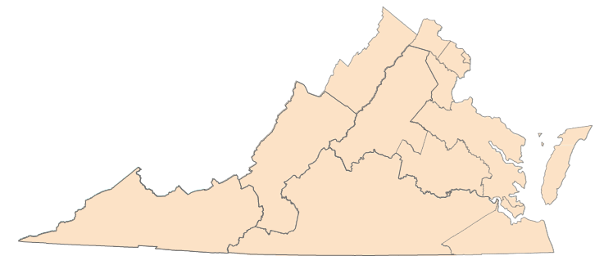
Guide to Regions of Virginia
Region 1 Alexandria City
Arlington
Region 2 Fairfax Fairfax City
Falls Church City
Region 5 Accomack | Region 8 Charles City | Region 10 Amelia | Patrick Petersburg City | Region 11 Bland | Region 12 Chesapeake City
Caroline | Chesterfield | Amherst | Pittsylvania | Bristol City | Franklin City
Essex | Goochland | Appomattox | Prince Edward | Buchanan | Isle of Wight
Gloucester | Hanover | Bedford | Prince George | Carroll | Norfolk City
James City | Henrico | Bedford City | Surrey | Dickenson | Portsmouth City
King and Queen | King William | Brunswick | Sussex | Floyd | Southampton
King George | New Kent | Buckingham |  | Galax City | Suffolk City
Lancaster | Powhatan | Campbell |  | Giles | Virginia Beach City
Mathews | Richmond City | Charlotte |  | Grayson
Middlesex |  | Colonial Heights City |  | Lee
Region 3 Fredericksburg City
Manassas City
Manassas Park City
Prince William
Stafford
Northampton
Northumberland
Poquoson City
Richmond
Spotsylvania
Westmoreland
Williamsburg City
York
Region 9
Alleghany
Augusta
Bath
Botetourt
Buena Vista City Covington City
Craig
Franklin
Highland Lexington City Roanoke
Roanoke City Rockbridge Salem City Staunton City
Waynesboro City
Cumberland
Danville City
Dinwiddie
Emporia City
Greensville
Halifax
Henry
Hopewell City
Lunenburg
Lynchburg City
Martinsville City
Mecklenburg
Nottoway
4
Montgomery
Norton City
Pulaski
Radford City
Russell
Scott
Smyth
Tazewell
Washington
Wise
Wythe
Region 13 Hampton City
Newport News City
Region 4
Clarke
Frederick Harrisonburg City Page Rockingham Shenandoah Warren Winchester City
Region 6
Loudoun
6
Region 7 Albemarle Charlottesville City Culpeper
Fauquier
Fluvanna
Greene
Louisa
Madison
Nelson
Orange
Rappahannock
2
3
1
7
5
9
8
11
10
13
12
for the Virginia Health Care Foundation

Slide 4
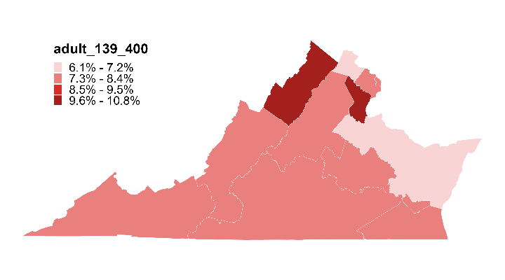
Map 1: Uninsured rate for all nonelderly (0-64)
Virginians in 2021, by region
Uninsurance Rate among Nonelderly
(VA Rate: 8.0%)
6
6.1%
2
7.8%
1
4
7.7%
10.3%
3
7
10.8%
9
7.3%
8.1%
8
5
7.4%
6.9%
11
10
13
7.6%
7.8%
12
7.7%
7.7%
Note: The uninsurance rate for all nonelderly Virginians in three regions exceeds the uninsurance rate for nonelderly Virginians overall.
Source: Urban Institute, March 2023. Based on the 2021 American Community Survey (ACS) data from the Integrated Public Use Microdata Series (IPUMS). For area definitions, see “Guide to Regions of Virginia”.
for the Virginia Health Care Foundation

Slide 5
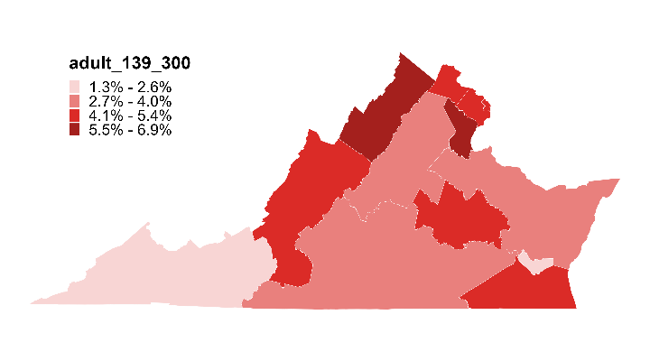
Map 2: Uninsured rate for all children (0-18)
in Virginia in 2021, by region
Uninsurance Rate among Children
(VA Rate: 4.4%)
6
4.4%
2
5.3%
1
4
4.9%
6.9%
3
7
6.4%
9
3.2%
4.2%
8
5
4.5%
3.6%
11
10
13
2.0%
3.3%
12
1.3%
4.2%
Note: The uninsurance rate for all Virginia children in five regions exceeds the uninsurance rate for all Virginia children, overall.
Source: Urban Institute, March 2023. Based on the 2021 American Community Survey (ACS) data from the Integrated Public Use Microdata Series (IPUMS). For area definitions, see “Guide to Regions of Virginia”.
for the Virginia Health Care Foundation

Slide 6
Map 3: Uninsured rate for all nonelderly adult (19-64)
Virginians in 2021, by region
Uninsurance Rate among nonelderly adults
(VA Rate: 9.4%)
6
6.9%
2
3.9%
1
4
8.5%
11.7%
3
7
12.8%
9
8.8%
9.6%
8
5
8.4%
8.3%
11
10
13
9.6%
9.5%
12
10.4%
9.2%
Note: The uninsurance rate for all nonelderly adult Virginians (19-64) in five regions exceeds the uninsurance rate for all nonelderly adult Virginians (19-64), overall.
Source: Urban Institute, March 2023. Based on the 2021 American Community Survey (ACS) data from the Integrated Public Use Microdata Series (IPUMS). For area definitions, see “Guide to Regions of Virginia”.
for the Virginia Health Care Foundation

Slide 7
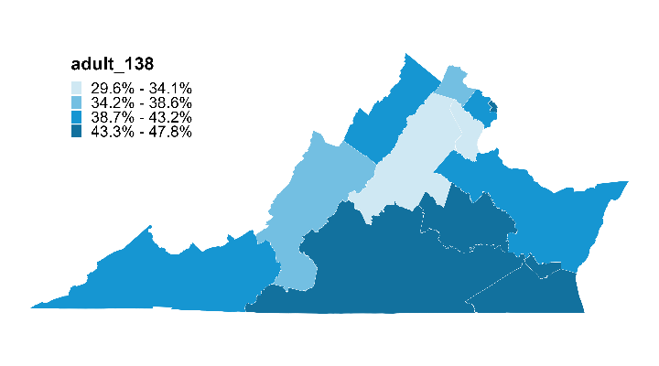
Map 4: Share of uninsured nonelderly adults (19-64) in Virginia with family income ≤138% FPL in 2021,
by region
Share of Uninsured
Adults ≤138% FPL
(VA Share: 41.2%)
6
37.5%
2
42.9%
1
4
47.6%
40.8%
3
7
32.3%
9
29.6%
35.2%
8
5
43.5%
42.1%
11
10
13
41.9%
46.1%
12
47.8%
45.1%
Note: The share of uninsured nonelderly adult Virginians (19-64) with family incomes at or below 138% FPL in 8 regions exceeds the share of uninsured nonelderly adult Virginians (19-64) with family income at or below 138% FPL in the state, overall.
Source: Urban Institute, March 2023. Based on the 2021 American Community Survey (ACS) data from the Integrated Public Use Microdata Series (IPUMS). For area definitions, see “Guide to Regions of Virginia”.
for the Virginia Health Care Foundation

Slide 8
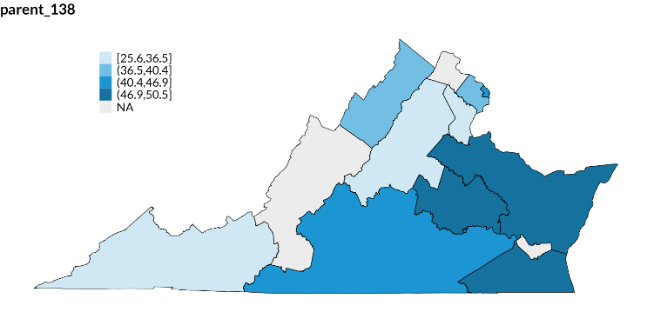
Map 5: Share of uninsured nonelderly adult
parents (19-64) in Virginia with family income
≤138% FPL in 2021, by region
Share of Uninsured
Parents ≤138% FPL
(VA Share: 38.6%)
Share of Uninsured
Parents ≤138% FPL
(VA Share: 38.6%)
6
NA
2
25.6% - 36.5%
36.5% - 40.4%
40.4% - 46.9%
46.9% - 50.5%
NA
39.9%
1
4
45.9%
37.8%
3
7
26.8%
9
25.6%
NA
8
5
47.5%
50.5%
11
10
13
40.9%
40.9%
12
NA
47.3%
Source: Urban Institute, March 2023. Based on the 2021 American Community Survey (ACS) data from the Integrated Public Use Microdata Series (IPUMS). For area definitions, see “Guide to Regions of Virginia”.
Notes: The share of uninsured nonelderly adult parents (19-64) in Virginia with family incomes at or below 138% FPL in 6 regions exceeds the share of uninsured nonelderly adult parents (19-64) in Virginia with family incomes at or below 138% FPL in the state, overall. “NA” stands for not applicable and refers to regions where the sample size from the ACS was less than n=50.
for the Virginia Health Care Foundation

Slide 9
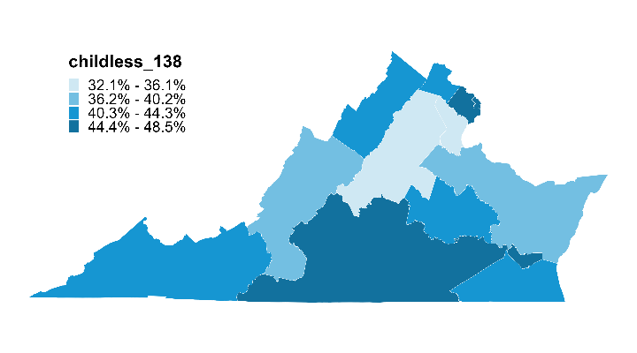
Map 6: Share of uninsured nonelderly childless
adults (19-64) in Virginia with family income
≤138% FPL in 2021, by region
Share of Uninsured Childless Adults ≤138% FPL
(VA Share: 42.3%)
6
44.1%
2
44.5%
1
4
48.5%
42.8%
3
7
35.1%
9
32.1%
37.2%
8
5
42.2%
38.0%
11
10
13
44.1%
47.3%
12
46.6%
44.3%
Note: The share of uninsured nonelderly childless adults (19-64) in Virginia with family incomes at or below 138% FPL in 8 regions exceeds the share of uninsured nonelderly childless adults (19-64) in Virginia with family incomes at or below 138% FPL in the state, overall.
Source: Urban Institute, March 2023. Based on the 2021 American Community Survey (ACS) data from the Integrated Public Use Microdata Series (IPUMS). For area definitions, see “Guide to Regions of Virginia”.
for the Virginia Health Care Foundation

Slide 10
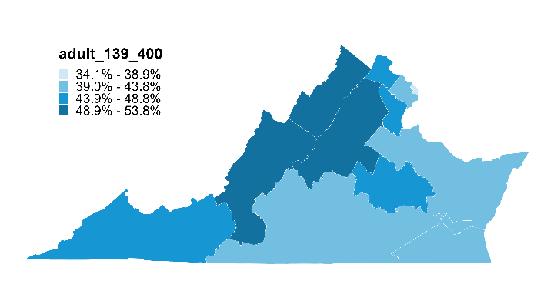
Map 7: Share of uninsured nonelderly adults (19-64) in Virginia with family income 139-400% FPL in 2021,
by region
Share of Uninsured Adults
139-400% FPL
(VA Share: 44.4%)
6
46.7%
2
40.1%
1
4
34.1%
51.5%
3
7
45.2%
9
53.8%
53.6%
8
5
45.9%
43.4%
11
10
13
46.1%
41.6%
12
42.5%
41.4%
Note: The share of uninsured nonelderly adult Virginians (19-64) with family income 139-400% FPL in 7 regions exceeds the share of uninsured nonelderly adult Virginians (19-64) with family income 139-400% FPL in the state, overall.
Source: Urban Institute, March 2023. Based on the 2021 American Community Survey (ACS) data from the Integrated Public Use Microdata Series (IPUMS). For area definitions, see “Guide to Regions of Virginia”.
for the Virginia Health Care Foundation

Slide 11
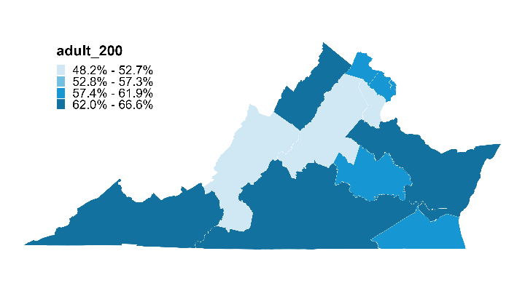
Map 8: Share of uninsured nonelderly adults (19-64) in Virginia with family income ≤200% FPL in 2021,
by region
Share of Uninsured
Adults ≤200% FPL
(VA Share: 59.0%)
6
59.9%
2
57.7%
1
4
61.8%
64.7%
3
7
48.2%
9
52.7%
52.4%
8
5
60.9%
64.1%
11
10
13
66.6%
62.5%
12
65.4%
59.8%
Notes: The share of uninsured nonelderly adults (19-64) in Virginia with family income at or below 200% FPL in 10 regions exceeds the share of uninsured nonelderly adults (19-64) in Virginia with family income at or below 200% FPL in the state, overall.
Source: Urban Institute, March 2023. Based on the 2021 American Community Survey (ACS) data from the Integrated Public Use Microdata Series (IPUMS). For area definitions, see “Guide to Regions of Virginia”.
for the Virginia Health Care Foundation

Slide 12
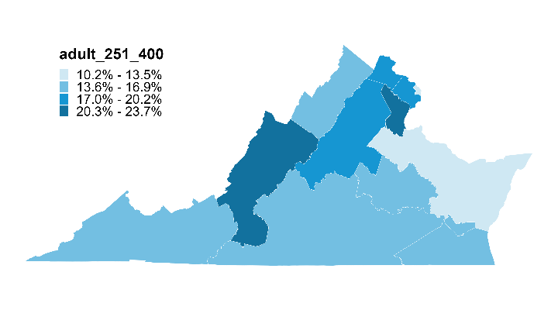
Map 9: Share of uninsured nonelderly adults (19-64) in Virginia with family income 251-400% FPL in 2021,
by region
Share of Uninsured Adults
251-400% FPL
(VA Share: 16.8%)
6
18.0%
2
17.2%
1
4
12.3%
14.7%
3
7
22.0%
9
17.9%
23.7%
8
5
16.5%
10.2%
11
10
13
15.3%
14.3%
12
14.1%
16.7%
Note: The share of uninsured nonelderly adult Virginians (19-64) with family income 251-400% FPL in 5 regions exceeds the share of uninsured nonelderly adult Virginians (19-64) with family income 251-400% FPL in the state, overall.
Source: Urban Institute, March 2023. Based on the 2021 American Community Survey (ACS) data from the Integrated Public Use Microdata Series (IPUMS). For area definitions, see “Guide to Regions of Virginia”.
for the Virginia Health Care Foundation

Slide 13
Map 10: Share of uninsured nonelderly adult (19-64) Virginians with family income ≤300% FPL in 2021, by region
Share of Uninsured
Nonelderly ≤300% FPL
(VA Share: 75.6%)
6
66.1%
2
65.7%
1
4
69.5%
77.6%
3
7
55.5%
9
65.5%
65.0%
8
5
73.0%
75.4%
11
10
13
72.7%
73.4%
12
76.3%
69.8%
Notes: The share of uninsured nonelderly adult (19-64) Virginians with family income at or below 300% FPL in 8 regions exceeds the share of uninsured nonelderly adult (19-64) Virginians with family income at or below 300% FPL in the state, overall.
Source: Urban Institute, March 2023. Based on the 2021 American Community Survey (ACS) data from the Integrated Public Use Microdata Series (IPUMS). For area definitions, see “Guide to Regions of Virginia”.
for the Virginia Health Care Foundation

Slide 14
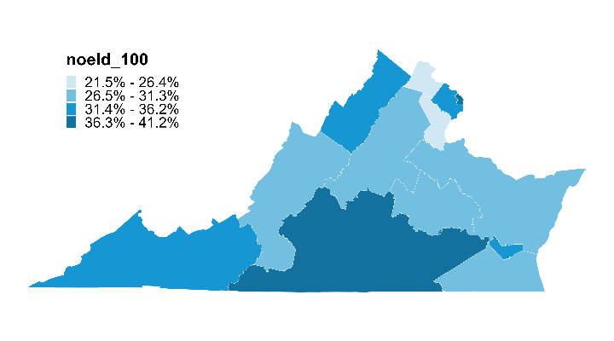
Map 11: Share of uninsured nonelderly (0-64) Virginians with family income ≤100% FPL in 2021, by region
Share of Uninsured
Nonelderly ≤100% FPL
(VA Share: 30.8%)
6
26.3%
2
33.4%
1
4
41.2%
32.2%
3
7
21.5%
9
26.8%
26.6%
8
5
31.1%
27.4%
11
10
13
34.5%
40.4%
12
34.7%
29.4%
Note: the share of uninsured nonelderly Virginians (0-64) with family income at or below 100% FPL in 6 regions exceeds the share of uninsured nonelderly Vriginians (0-64) with family income at or below 100% FPL in the state, overall.
Source: Urban Institute, March 2023. Based on the 2021 American Community Survey (ACS) data from the Integrated Public Use Microdata Series (IPUMS). For area definitions, see “Guide to Regions of Virginia”.
for the Virginia Health Care Foundation

