Slide 1
A Profile of Virginia’s Uninsured in 2021
April 2023
Adele Shartzer, Julia Long, Avani Pugazhendhi, and Jenny Haley
Urban Institute

Slide 2
Main Takeaways for 2021
There were about 559,000 nonelderly (ages 0-64) uninsured in Virginia in 2021, resulting in a 1.4% reduction in the rate of uninsured nonelderly Virginians (from 9.4% in 2019 to 8.0% in 2021).
The reduction in uninsurance coincides with the state’s expansion of Medicaid to include low-income nonelderly adults and Medicaid’s continuous coverage provisions during the COVID-19 pandemic. The national uninsured rate for the nonelderly also decreased from 2019 (10.8%) to 2021 (10.2%).
Uninsured adult Virginians were much more likely than insured adults to have unmet health needs and less likely to receive preventive services.
for the Virginia Health Care Foundation

Slide 3
Main Takeaways for 2021
In 2021, about half (45.5% or 328,000) of uninsured nonelderly Virginians lived in families with income at or below 200% of the Federal Poverty Level (FPL), down from 51.9% (385,000) in 2018.
More than half (57.9% or 50,000) of uninsured children in Virginia lived in families with income at or below 205% FPL in 2021, compared to 2019 (52,000 or 60%).
Most (84.4%) nonelderly uninsured Virginians were adults; 37.7% were white and 83.0% were in families with at least one working adult.
Nonelderly uninsured rates were highest in two regions of the state: the Fredericksburg City/Prince William County area (10.8%) and the upper Shenandoah Valley region (10.3%).
for the Virginia Health Care Foundation

Slide 4
559,000 Virginians lacked health insurance coverage in 2021, 84.4% of whom were adults
Total Nonelderly
Virginians
Nonelderly Uninsured
Virginians
Source: Urban Institute, March 2023. Based on the 2021 American Community Survey (ACS) data from the Integrated Public Use Microdata Series (IPUMS).
for the Virginia Health Care Foundation

Slide 5
Nonelderly adults (19-64) were more than twice as likely to be uninsured as children in Virginia in 2021
Source: Urban Institute, March 2023. Based on the 2021 American Community Survey (ACS) data from the Integrated Public Use Microdata Series (IPUMS).
for the Virginia Health Care Foundation

Slide 6
A vast majority of uninsured children and adults in Virginia were potentially eligible for Medicaid, CHIP, or Marketplace financial assistance based on income
Source: Urban Institute, March 2023. Based on the 2021 American Community Survey (ACS) data from the Integrated Public Use Microdata Series (IPUMS).

Slide 7
The rate of uninsurance for nonelderly adult Virginians decreased significantly for every age group between 2013 and 2021.
Source: Urban Institute, March 2023. Based on the 2021 American Community Survey (ACS) data from the Integrated Public Use Microdata Series (IPUMS). All differences between 2013 and 2021 are significant at the .10 level.

Slide 8
Virginia’s reductions in uninsurance among all nonelderly continued in 2021, outpacing reductions nationally
Note: Implementation of primary elements of the Affordable Care Act began in 2014, to include the Health Insurance Marketplace and Marketplace-related financial assistance. Virginia’s Medicaid eligibility requirements expanded to include adults ≤138% FPL in 2019.
Source: Urban Institute, March 2023. Based on the 2013, 2018, 2019, and 2021 American Community Survey (ACS) data from the Integrated Public Use Microdata Series (IPUMS). The estimates reflect Urban Institute adjustments for potential misreporting of coverage.
for the Virginia Health Care Foundation

Slide 9
Uninsurance in Virginia decreased among both nonelderly adults and children between in 2013 and 2021
Note: Implementation of primary elements of the Affordable Care Act began in 2014, to include the Health Insurance Marketplace and Marketplace-related financial assistance. Virginia’s Medicaid eligibility requirements expanded to include adults ≤138% FPL in 2019.
Source: Urban Institute, March 2023. Based on the 2013, 2018, 2019, and 2021 American Community Survey (ACS) data from the Integrated Public Use Microdata Series (IPUMS).
for the Virginia Health Care Foundation

Slide 10
Nearly a third of nonelderly uninsured Virginians had family income ≤100% FPL in 2021, and half had income ≤200% FPL
Source: Urban Institute, March 2023. Based on the 2021 American Community Survey (ACS) data from the Integrated Public Use Microdata Series (IPUMS).
Notes: Family poverty level estimates are based on tax unit Modified Adjusted Gross Income and use the 2021 Federal Poverty Levels (FPLs) defined by the US Department of Health and Human Services.
for the Virginia Health Care Foundation

Slide 11
Adult Virginians (19-64) with incomes 100-200% FPL were more than 7 times as likely to be uninsured as adult Virginians with incomes 401+% FPL in 2021
Children with family incomes in the 100%-200% FPL range were more than
4 times as likely to be uninsured as those in families with the highest incomes.
Source: Urban Institute, March 2023. Based on the 2021 American Community Survey (ACS) data from the Integrated Public Use Microdata Series (IPUMS). The estimates reflect Urban Institute adjustments for potential misreporting of coverage.
Notes: Family poverty level estimates are based on tax unit Modified Adjusted Gross Income and use the 2021 Federal Poverty Levels (FPLs) defined by the US Department of Health and Human Services.
for the Virginia Health Care Foundation

Slide 12
More than 80% of uninsured Virginians lived in families with at least one adult working full- or part-time in 2021
Share of Nonelderly Uninsured
Source: Urban Institute, March 2023. Based on the 2021 American Community Survey (ACS) data from the Integrated Public Use Microdata Series (IPUMS).
Notes: Family work status is based on the work status of adults in the tax unit. Estimates may not sum to 100% due to rounding.
for the Virginia Health Care Foundation

Slide 13
Full-time workers and their families comprised 70.1% of the uninsured in Virginia and were distributed over all income levels in 2021
Source: Urban Institute, March 2023. Based on the 2021 American Community Survey (ACS) data from the Integrated Public Use Microdata Series (IPUMS).
Notes: Family work status is based on the work status of adults in the tax unit. Family poverty level estimates are based on tax unit Modified Adjusted Gross Income and use the 2021 Federal Poverty Levels (FPLs) defined by the US Department of Health and Human Services. Estimates may not sum to 100% due to rounding.
for the Virginia Health Care Foundation

Slide 14
While 38% of uninsured nonelderly Virginians were
non-Hispanic white, Hispanic Virginians were more likely to be uninsured than other races/ethnicities
Source: Urban Institute, March 2023. Based on the 2021 American Community Survey (ACS) data from the Integrated Public Use Microdata Series (IPUMS). The estimates reflect Urban Institute adjustments for potential misreporting of coverage.
Notes: Estimates may not sum to 100% due to rounding.
for the Virginia Health Care Foundation

Slide 15
Among nonelderly Virginians, uninsured adults were less likely than insured adults to receive healthcare in 2021
Source: Urban Institute, March 2023. Based on the 2021 Behavioral Risk Factor Surveillance System.
Notes: */**/*** Denotes estimate is significantly different from estimate for insured at the 0.1/0.05/0.01 percent level. Adults are age 18-64. Measures refer to access or utilization over the past 12 months.

Slide 16
Methods
All data are from the American Community Survey (ACS) and the Behavioral Risk Factor Surveillance System (BRFSS), which are conducted by the US Census Bureau and the Centers for Disease Control and Prevention, respectively.
This report provides more in-depth information than the tables produced by the US Census Bureau.
The family structures and corresponding income and employment estimates presented in the ACS analyses are based on tax units, or groups of individuals whose income would likely be counted together for the purposes of eligibility for Medicaid or the Marketplace. Tax units are generally smaller than Census-reported families, and their income is generally lower than the Census estimates of family-based income. As a result, the ACS estimates of the number of uninsured by income may not match those from other sources that are based on alternative family and income units.
In January 2019, Virginia expanded its Medicaid program under the Affordable Care Act to nonelderly adults with family income up to 138% FPL. The federal policy response to the COVID-19 pandemic also included provisions to protect access to health insurance through Medicaid/CHIP and the Marketplaces. As a result, very few people were disenrolled, starting in March 2020.
The Medicaid continuous coverage provisions increased the potential misreporting of Medicaid/CHIP coverage, and so the ACS estimates in this analysis do not include additional Urban Institute adjustments for potential misreporting of Medicaid/CHIP coverage. Estimates in this Profile should not be compared to previous Profiles.
for the Virginia Health Care Foundation

Slide 17
A Profile of Virginia’s Uninsured in 2021: Maps

Slide 18
Table of Contents
Guide to Regions of Virginia
Map 1: Uninsured rate for all nonelderly (0-64) Virginians in 2021, by region
Map 2: Uninsured rate for all children (0-18) in Virginia in 2021, by region
Map 3: Uninsured rate for all nonelderly adult (19-64) Virginians in 2021, by region
Map 4: Share of uninsured nonelderly adults (19-64) in Virginia with family income ≤138% FPL in 2021, by region
Map 5: Share of uninsured nonelderly adult parents (19-64) in Virginia with family income ≤138% FPL in 2021, by region
Map 6: Share of uninsured nonelderly childless adults (19-64) in Virginia with family income ≤138% FPL in 2021, by region
Map 7: Share of uninsured nonelderly adults (19-64) in Virginia with family income 139-400% FPL in 2021, by region
Map 8: Share of uninsured nonelderly adults (19-64) in Virginia with family income ≤200% FPL in 2021, by region
Map 9: Share of uninsured nonelderly adults (19-64) in Virginia with family income 251-400% FPL in 2021, by region
Map 10: Share of uninsured nonelderly adults (19-64) in Virginia with family income ≤300% FPL in 2021,by region
Map 11: Share of uninsured nonelderly (0-64) Virginians with family income ≤100% FPL in 2021, by region
Notes: “Uninsured rate” refers to the percentage of Virginians in the specified group who are uninsured. “Share of uninsured” refers to the percentage of the uninsured who are in the specified group. Maps showing rates use a red color scheme. Maps showing share use a blue color scheme.
for the Virginia Health Care Foundation

Slide 19
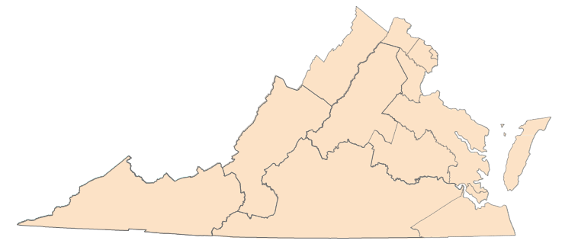
Guide to Regions of Virginia
Region 1 Alexandria City
Arlington
Region 2 Fairfax Fairfax City
Falls Church City
Region 5 Accomack | Region 8 Charles City | Region 10 Amelia | Patrick Petersburg City | Region 11 Bland | Region 12 Chesapeake City
Caroline | Chesterfield | Amherst | Pittsylvania | Bristol City | Franklin City
Essex | Goochland | Appomattox | Prince Edward | Buchanan | Isle of Wight
Gloucester | Hanover | Bedford | Prince George | Carroll | Norfolk City
James City | Henrico | Bedford City | Surrey | Dickenson | Portsmouth City
King and Queen | King William | Brunswick | Sussex | Floyd | Southampton
King George | New Kent | Buckingham |  | Galax City | Suffolk City
Lancaster | Powhatan | Campbell |  | Giles | Virginia Beach City
Mathews | Richmond City | Charlotte |  | Grayson
Middlesex |  | Colonial Heights City |  | Lee
Region 3 Fredericksburg City
Manassas City
Manassas Park City
Prince William
Stafford
Northampton
Northumberland
Poquoson City
Richmond
Spotsylvania
Westmoreland
Williamsburg City
York
Region 9
Alleghany
Augusta
Bath
Botetourt
Buena Vista City Covington City
Craig
Franklin
Highland Lexington City Roanoke
Roanoke City Rockbridge Salem City Staunton City
Waynesboro City
Cumberland
Danville City
Dinwiddie
Emporia City
Greensville
Halifax
Henry
Hopewell City
Lunenburg
Lynchburg City
Martinsville City
Mecklenburg
Nottoway
4
Montgomery
Norton City
Pulaski
Radford City
Russell
Scott
Smyth
Tazewell
Washington
Wise
Wythe
Region 13 Hampton City
Newport News City
Region 4
Clarke
Frederick Harrisonburg City Page Rockingham Shenandoah Warren Winchester City
Region 6
Loudoun
6
Region 7 Albemarle Charlottesville City Culpeper
Fauquier
Fluvanna
Greene
Louisa
Madison
Nelson
Orange
Rappahannock
2
3
1
7
5
9
8
11
10
13
12
for the Virginia Health Care Foundation

Slide 20
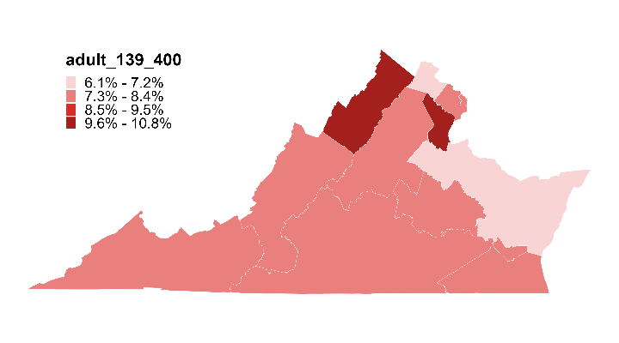
Map 1: Uninsured rate for all nonelderly (0-64)
Virginians in 2021, by region
Uninsurance Rate among Nonelderly
(VA Rate: 8.0%)
6
6.1%
2
7.8%
1
4
7.7%
10.3%
3
7
10.8%
9
7.3%
8.1%
8
5
7.4%
6.9%
11
10
13
7.6%
7.8%
12
7.7%
7.7%
Note: The uninsurance rate for all nonelderly Virginians in three regions exceeds the uninsurance rate for nonelderly Virginians overall.
Source: Urban Institute, March 2023. Based on the 2021 American Community Survey (ACS) data from the Integrated Public Use Microdata Series (IPUMS). For area definitions, see “Guide to Regions of Virginia”.
for the Virginia Health Care Foundation

Slide 21
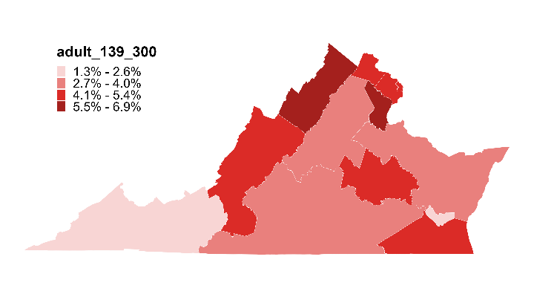
Map 2: Uninsured rate for all children (0-18)
in Virginia in 2021, by region
Uninsurance Rate among Children
(VA Rate: 4.4%)
6
4.4%
2
5.3%
1
4
4.9%
6.9%
3
7
6.4%
9
3.2%
4.2%
8
5
4.5%
3.6%
11
10
13
2.0%
3.3%
12
1.3%
4.2%
Note: The uninsurance rate for all Virginia children in five regions exceeds the uninsurance rate for all Virginia children, overall.
Source: Urban Institute, March 2023. Based on the 2021 American Community Survey (ACS) data from the Integrated Public Use Microdata Series (IPUMS). For area definitions, see “Guide to Regions of Virginia”.
for the Virginia Health Care Foundation

Slide 22
Map 3: Uninsured rate for all nonelderly adult (19-64)
Virginians in 2021, by region
Uninsurance Rate among nonelderly adults
(VA Rate: 9.4%)
6
6.9%
2
3.9%
1
4
8.5%
11.7%
3
7
12.8%
9
8.8%
9.6%
8
5
8.4%
8.3%
11
10
13
9.6%
9.5%
12
10.4%
9.2%
Note: The uninsurance rate for all nonelderly adult Virginians (19-64) in five regions exceeds the uninsurance rate for all nonelderly adult Virginians (19-64), overall.
Source: Urban Institute, March 2023. Based on the 2021 American Community Survey (ACS) data from the Integrated Public Use Microdata Series (IPUMS). For area definitions, see “Guide to Regions of Virginia”.
for the Virginia Health Care Foundation

Slide 23
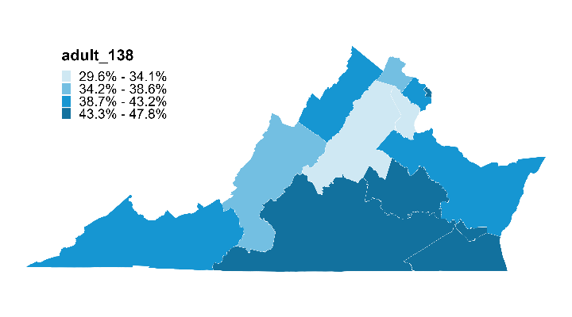
Map 4: Share of uninsured nonelderly adults (19-64) in Virginia with family income ≤138% FPL in 2021,
by region
Share of Uninsured
Adults ≤138% FPL
(VA Share: 41.2%)
6
37.5%
2
42.9%
1
4
47.6%
40.8%
3
7
32.3%
9
29.6%
35.2%
8
5
43.5%
42.1%
11
10
13
41.9%
46.1%
12
47.8%
45.1%
Note: The share of uninsured nonelderly adult Virginians (19-64) with family incomes at or below 138% FPL in 8 regions exceeds the share of uninsured nonelderly adult Virginians (19-64) with family income at or below 138% FPL in the state, overall.
Source: Urban Institute, March 2023. Based on the 2021 American Community Survey (ACS) data from the Integrated Public Use Microdata Series (IPUMS). For area definitions, see “Guide to Regions of Virginia”.
for the Virginia Health Care Foundation

Slide 24
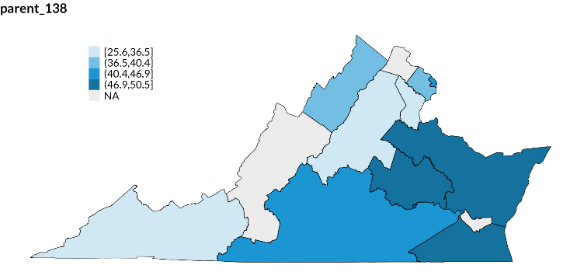
Map 5: Share of uninsured nonelderly adult
parents (19-64) in Virginia with family income
≤138% FPL in 2021, by region
Share of Uninsured
Parents ≤138% FPL
(VA Share: 38.6%)
Share of Uninsured
Parents ≤138% FPL
(VA Share: 38.6%)
6
NA
2
25.6% - 36.5%
36.5% - 40.4%
40.4% - 46.9%
46.9% - 50.5%
NA
39.9%
1
4
45.9%
37.8%
3
7
26.8%
9
25.6%
NA
8
5
47.5%
50.5%
11
10
13
40.9%
40.9%
12
NA
47.3%
Source: Urban Institute, March 2023. Based on the 2021 American Community Survey (ACS) data from the Integrated Public Use Microdata Series (IPUMS). For area definitions, see “Guide to Regions of Virginia”.
Notes: The share of uninsured nonelderly adult parents (19-64) in Virginia with family incomes at or below 138% FPL in 6 regions exceeds the share of uninsured nonelderly adult parents (19-64) in Virginia with family incomes at or below 138% FPL in the state, overall. “NA” stands for not applicable and refers to regions where the sample size from the ACS was less than n=50.
for the Virginia Health Care Foundation

Slide 25
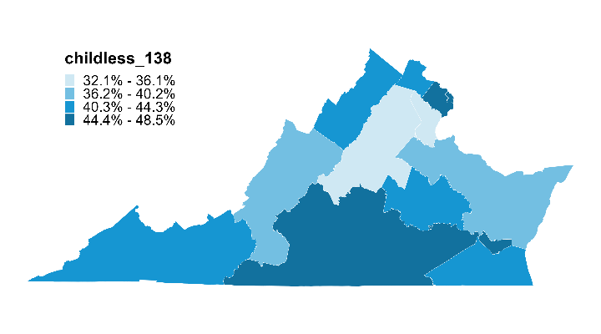
Map 6: Share of uninsured nonelderly childless
adults (19-64) in Virginia with family income
≤138% FPL in 2021, by region
Share of Uninsured Childless Adults ≤138% FPL
(VA Share: 42.3%)
6
44.1%
2
44.5%
1
4
48.5%
42.8%
3
7
35.1%
9
32.1%
37.2%
8
5
42.2%
38.0%
11
10
13
44.1%
47.3%
12
46.6%
44.3%
Note: The share of uninsured nonelderly childless adults (19-64) in Virginia with family incomes at or below 138% FPL in 8 regions exceeds the share of uninsured nonelderly childless adults (19-64) in Virginia with family incomes at or below 138% FPL in the state, overall.
Source: Urban Institute, March 2023. Based on the 2021 American Community Survey (ACS) data from the Integrated Public Use Microdata Series (IPUMS). For area definitions, see “Guide to Regions of Virginia”.
for the Virginia Health Care Foundation

Slide 26
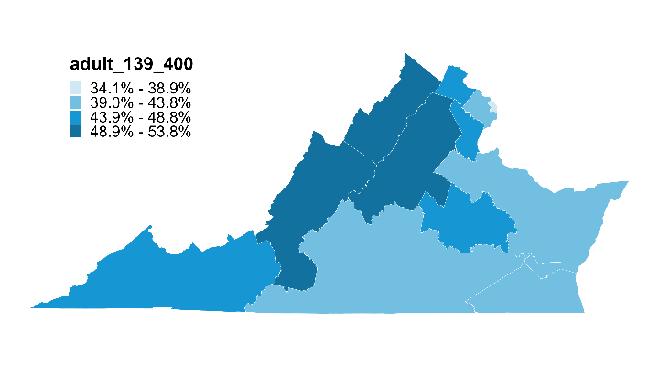
Map 7: Share of uninsured nonelderly adults (19-64) in Virginia with family income 139-400% FPL in 2021,
by region
Share of Uninsured Adults
139-400% FPL
(VA Share: 44.4%)
6
46.7%
2
40.1%
1
4
34.1%
51.5%
3
7
45.2%
9
53.8%
53.6%
8
5
45.9%
43.4%
11
10
13
46.1%
41.6%
12
42.5%
41.4%
Note: The share of uninsured nonelderly adult Virginians (19-64) with family income 139-400% FPL in 7 regions exceeds the share of uninsured nonelderly adult Virginians (19-64) with family income 139-400% FPL in the state, overall.
Source: Urban Institute, March 2023. Based on the 2021 American Community Survey (ACS) data from the Integrated Public Use Microdata Series (IPUMS). For area definitions, see “Guide to Regions of Virginia”.
for the Virginia Health Care Foundation

Slide 27
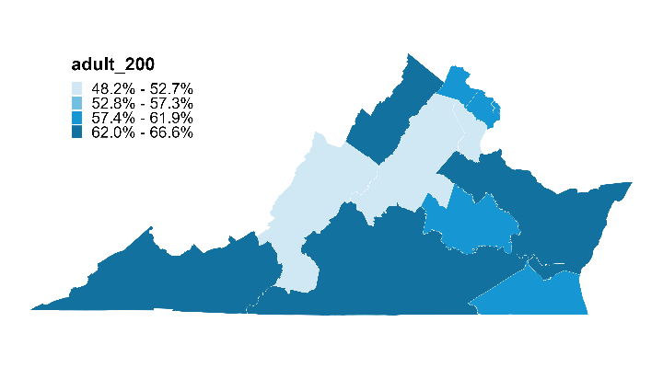
Map 8: Share of uninsured nonelderly adults (19-64) in Virginia with family income ≤200% FPL in 2021,
by region
Share of Uninsured
Adults ≤200% FPL
(VA Share: 59.0%)
6
59.9%
2
57.7%
1
4
61.8%
64.7%
3
7
48.2%
9
52.7%
52.4%
8
5
60.9%
64.1%
11
10
13
66.6%
62.5%
12
65.4%
59.8%
Notes: The share of uninsured nonelderly adults (19-64) in Virginia with family income at or below 200% FPL in 10 regions exceeds the share of uninsured nonelderly adults (19-64) in Virginia with family income at or below 200% FPL in the state, overall.
Source: Urban Institute, March 2023. Based on the 2021 American Community Survey (ACS) data from the Integrated Public Use Microdata Series (IPUMS). For area definitions, see “Guide to Regions of Virginia”.
for the Virginia Health Care Foundation

Slide 28
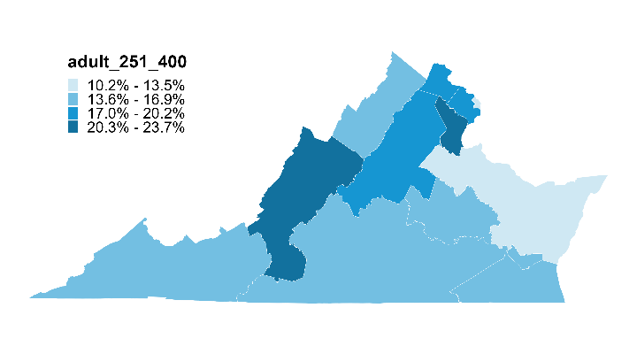
Map 9: Share of uninsured nonelderly adults (19-64) in Virginia with family income 251-400% FPL in 2021,
by region
Share of Uninsured Adults
251-400% FPL
(VA Share: 16.8%)
6
18.0%
2
17.2%
1
4
12.3%
14.7%
3
7
22.0%
9
17.9%
23.7%
8
5
16.5%
10.2%
11
10
13
15.3%
14.3%
12
14.1%
16.7%
Note: The share of uninsured nonelderly adult Virginians (19-64) with family income 251-400% FPL in 5 regions exceeds the share of uninsured nonelderly adult Virginians (19-64) with family income 251-400% FPL in the state, overall.
Source: Urban Institute, March 2023. Based on the 2021 American Community Survey (ACS) data from the Integrated Public Use Microdata Series (IPUMS). For area definitions, see “Guide to Regions of Virginia”.
for the Virginia Health Care Foundation

Slide 29
Map 10: Share of uninsured nonelderly adult (19-64) Virginians with family income ≤300% FPL in 2021, by region
Share of Uninsured
Nonelderly ≤300% FPL
(VA Share: 75.6%)
6
66.1%
2
65.7%
1
4
69.5%
77.6%
3
7
55.5%
9
65.5%
65.0%
8
5
73.0%
75.4%
11
10
13
72.7%
73.4%
12
76.3%
69.8%
Notes: The share of uninsured nonelderly adult (19-64) Virginians with family income at or below 300% FPL in 8 regions exceeds the share of uninsured nonelderly adult (19-64) Virginians with family income at or below 300% FPL in the state, overall.
Source: Urban Institute, March 2023. Based on the 2021 American Community Survey (ACS) data from the Integrated Public Use Microdata Series (IPUMS). For area definitions, see “Guide to Regions of Virginia”.
for the Virginia Health Care Foundation

Slide 30
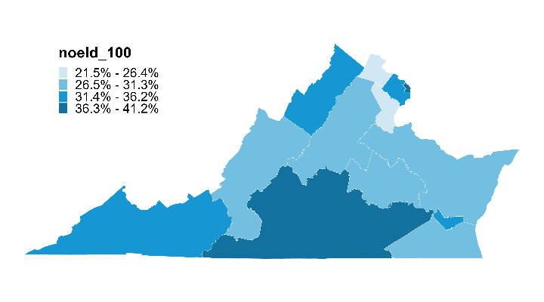
Map 11: Share of uninsured nonelderly (0-64) Virginians with family income ≤100% FPL in 2021, by region
Share of Uninsured
Nonelderly ≤100% FPL
(VA Share: 30.8%)
6
26.3%
2
33.4%
1
4
41.2%
32.2%
3
7
21.5%
9
26.8%
26.6%
8
5
31.1%
27.4%
11
10
13
34.5%
40.4%
12
34.7%
29.4%
Note: the share of uninsured nonelderly Virginians (0-64) with family income at or below 100% FPL in 6 regions exceeds the share of uninsured nonelderly Vriginians (0-64) with family income at or below 100% FPL in the state, overall.
Source: Urban Institute, March 2023. Based on the 2021 American Community Survey (ACS) data from the Integrated Public Use Microdata Series (IPUMS). For area definitions, see “Guide to Regions of Virginia”.
for the Virginia Health Care Foundation

