Slide 1
The State of Mental Health
of Virginia's Youth
Andrea Lancaster
Chief Program & Impact Officer
Virginia Health Care Foundation

Slide 2
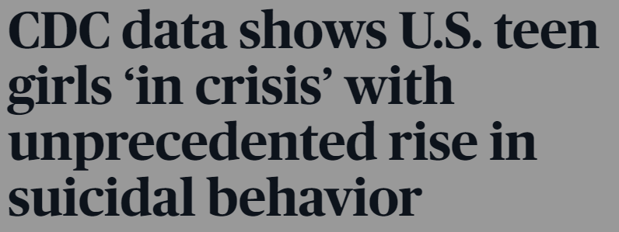
Notes:
A small sample of headlines from the past couple of years.

Slide 3
Virginia youth who reported feeling so
sad or hopeless almost every day for 2 weeks or more in a row that they stopped doing some usual activities
High School
Middle School
Notes:
40% of Virginia high schoolers and 34% of Virginia middle schoolers Data from 2022 (high school) and 2021 (middle school) Virginia School Surveys of Climate and Working Conditions. https://www.dcjs.virginia.gov/virginia-center-school-and-campus-safety/school-safety-survey/secondary-school-climate-survey

Slide 4
Percentage of high schoolers who spent at least several days during the past two weeks feeling:
Unable to Stop/Control Worrying
Nervous/Anxious
61%
53%
Little Interest/Pleasure in doing things
Depressed/Hopeless
50%
55%
Notes:
More than half of high schoolers responded that they spent at least several days, more than half the days, or nearly every day feeling… nervous/anxious, unable to stop or control worrying, depressed or hopeless, or having little interest or pleasure in doing things.
Data from 2022 (high school) and Virginia School Surveys of Climate and Working Conditions. https://www.dcjs.virginia.gov/virginia-center-school-and-campus-safety/school-safety-survey/secondary-school-climate-survey

Slide 5
Not just high schoolers...
Percentage of middle schoolers who spent at least several days during the past two weeks feeling:
Unable to Stop/Control Worrying
Nervous/Anxious
50%
39%
Notes:
Middle school survey only asked about nervous/anxious feelings and inability to stop or control worrying. Not quite as high as the high school rates, but still significant portions of students.
Data from 2021 (middle school) Virginia School Surveys of Climate and Working Conditions. https://www.dcjs.virginia.gov/virginia-center-school-and-campus-safety/school-safety-survey/secondary-school-climate-survey

Slide 6
12.7% of high schoolers seriously considered suicide in past 12 months
12.7% seriously considered suicide
56% of those made a plan
59% of those made an attempt
4.2% of high schoolers reported attempting suicide at least once
Notes:
For middle schoolers, 10% seriously considered suicide, but then the percentage of those that made a plan and then the percentage of those that made an attempt were similar (55-60%)
Data from 2022 (high school) and 2021 (middle school) Virginia School Surveys of Climate and Working Conditions. https://www.dcjs.virginia.gov/virginia-center-school-and-campus-safety/school-safety-survey/secondary-school-climate-survey

Slide 7
Percentage of high schoolers who seriously considered suicide
Gender
Female
Male
Non-Binary
Did not disclose
0%
10%
20%
30%
40%
50%
Notes:
18.8% of female students, 8.3% of male students, 41.2% of nonbinary students, and 23.4% of students that did not disclose a gender seriously considered suicide in the past 12 months
Data from 2022 (high school) and 2021 (middle school) Virginia School Surveys of Climate and Working Conditions. https://www.dcjs.virginia.gov/virginia-center-school-and-campus-safety/school-safety-survey/secondary-school-climate-survey

Slide 8
Percentage of high schoolers who seriously considered suicide
Race/Ethnicity
White
Black/African American
Hispanic/Latinx
Asian
American Indian/Alaska Native
Other
0%
5%
10%
15%
20%
Notes:
17.3% of white students, 12% of Black/African American students, 13.7% of Hispanic/Latino students, 9.3% of Asian students, 17% of American Indian or Alaska Native students, and 12.3% of students who classified their race/ethnicity as “other” seriously considered suicide.
Data from 2022 (high school) and 2021 (middle school) Virginia School Surveys of Climate and Working Conditions. https://www.dcjs.virginia.gov/virginia-center-school-and-campus-safety/school-safety-survey/secondary-school-climate-survey

Slide 9
Virginia Youth Suicide Rates
per 100,000
8
6
4
2
0
2015
2016
2017
2018
2019
2020
2021
Notes:
Peak in 2020, but clear upward trend line.
Data from VDH report on self-harm and suicide hospital utilization https://www.vdh.virginia.gov/content/uploads/sites/110/2022/04/Youth_SelfHarm_Suicide_Report.pdf

Slide 10
119% Increase over 5 years in youth ED visits for self-harm, suicide attempts, and suicidal thoughts
2021
14,298 self-harm ED visits
2016
6,520
self-harm ED visits
Notes:
Rates of ED utilization for self-harm, suicide attempts, and suicidal thoughts among youth have more than doubled in only 5 years. https://www.vdh.virginia.gov/content/uploads/sites/110/2022/04/Youth_SelfHarm_Suicide_Report.pdf

Slide 11
Trauma and Toxic Stress
High
School
Middle
School
44% 35%
Bullying is a problem at my school
27% 18%
Ever lived with someone with problem with drugs or alcohol
32% 20%
Ever lived with someone who was depressed, mentally ill, or suicidal
Ever separated from parent/guardian because they went to jail, prison, or detention center
12% 11%
Notes:
A small sample of ACEs and toxic stress.
Data from 2022 (high school) and 2021 (middle school) Virginia School Surveys of Climate and Working Conditions. https://www.dcjs.virginia.gov/virginia-center-school-and-campus-safety/school-safety-survey/secondary-school-climate-survey

Slide 12
CDC Pulse Survey
75%
Between June 2022 and February 2023, an average of 57% of VA parents reported at least one mental health symptom for their child(ren)
50%
25%
0%
June
July
August
October
January
February
September
November
December
Notes:
Slight increase at beginning of school year, but increase again in February. From CDC Pulse survey, which only added questions about children’s mental health symptoms midway through 2022.
https://www.cdc.gov/nchs/covid19/pulse/mental-health.htm

Slide 13
Symptoms Reported
Outgrown Behaviors
3%
Complaints of Physical Pain
8%
Anxious/Clingy
24%
Problematic Behaviors
6%
Unusual Anger/Outbursts
12%
Depressed/Sad
14%
Changes in Ability to Focus
17%
Eating Behaviors
16%
Notes:
Breakdown of the symptoms reported by Virginia parents in the CDC Pulse survey. These are percentages of the reported symptoms. Many respondents reported multiple symptoms in their family. The most common ones were the child or children feeling more anxious or clingy, depressed or sad, exhibiting changes in their normal eating behaviors, exhibiting changes in their ability to focus. Less common ones were unusual anger or outbursts, other problematic behaviors, complaints of physical pain with no medical cause, and regressing to previously outgrown behaviors.
https://www.cdc.gov/nchs/covid19/pulse/mental-health.htm

Slide 14
Resilience/Community Factors
High
School
Middle
School
44% 49%
At least one teacher or other trusted adult I can turn to when I feel sad or hopeless
75% 85%
Would tell an adult at school if another student talked about harming themselves
74% 50%
I feel safe in my classes
62% 73%
Students in my school care about me
81% 92%
Adults at my school care about me
23% 12%
Ever received suicide prevention or mental health training
Notes:
A very small sample of positive, resilience-building, or community protective factors for Virginia’s children.
Data from 2022 (high school) and 2021 (middle school) Virginia School Surveys of Climate and Working Conditions. https://www.dcjs.virginia.gov/virginia-center-school-and-campus-safety/school-safety-survey/secondary-school-climate-survey

Slide 15
of students statewide were chronically absent (>10 days) in the 2021-2022 school year
20%
Student behavior problems were rated as the most serious of 15 issues faced by school staff
in a 2021 JLARC survey
Notes:
As we saw in the last slide, many children in VA feel safe at school, feel like the adults care about them, and have a trusted adult they can talk to. But a significant portion of Virginia’s children are also missing from school. In addition, many are struggling to engage productively while they are at school, with student behavior problems being rated by school staff as the most serious of 15 issues in a JLARC survey
http://jlarc.virginia.gov/landing-2022-pandemic-impact-on-k-12-education.asp

Slide 16
Virginia's Ranking
48
For Youth Mental Health
in Mental Health America's
2023 State Rankings, based on prevalence and access to care
TH
Notes:
Virginia’s overall ranking in Mental Health America’s 2023 State Rankings is very close to the bottom. This means Virginia has a higher prevalence of mental health conditions among youth and less access to care.
The seven measures that make up the Youth Ranking include:
Youth with at Least One Major Depressive Episode (MDE) in the Past Year
Youth with Substance Use Disorder in the Past Year
Youth with Severe MDE
Youth with MDE Who Did Not Receive Mental Health Services
Youth with Severe MDE Who Received Some Consistent Treatment
Youth with Private Insurance That Did Not Cover Mental or Emotional Problems
Students (K+) Identified with Emotional Disturbance for an Individualized Education Program.
https://mhanational.org/issues/2023/mental-health-america-youth-data

Slide 17
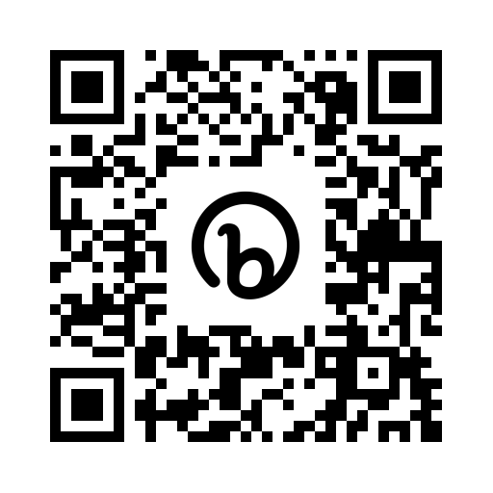
Mental Health Roundtable: Legislative Update
Tuesday, April 18, 2023
10 am – 12 pm
Register:
bit.ly/legislativeMHRT
Questions? Contact:
Andrea Lancaster
andrea@vhcf.org
Or Denise Daly Konrad
dkonrad@vhcf.org
Notes:
bit.ly/legislativeMHRT

Slide 18
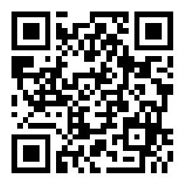
Evaluation
www.slido.com
Participant Code:
#MHRT32023
Notes:
https://app.sli.do/event/7NhJ6pXnW1oJwUK2AN3r2P

