Slide 1
A Profile of Virginia’s Uninsured in 2022
March 2024
Laura Skopec, Vincent Pancini, Avani Pugazhendhi, Jennifer Haley, and Adele Shartzer
Urban Institute

Slide 2
Main Takeaways for 2022 (1)
There were about 544,000 nonelderly (ages 0-64) uninsured in Virginia in 2022.
Between 2019 and 2022, the Virginia nonelderly uninsured rate fell 1.6 percentage points (from 9.4% to 7.7%). The change in uninsurance from 2021 to 2022 was not statistically significant (from 8.0% to 7.7%).
The reduction in uninsurance since 2019 coincides with the state’s expansion of Medicaid to include low-income nonelderly adults, Medicaid’s continuous coverage provisions during the COVID-19 pandemic, and expanded Marketplace subsidies under the American Rescue Plan Act in 2020.
Uninsured adult Virginians were much more likely than insured adults to have unmet health needs and less likely to receive preventive services.
for the Virginia Health Care Foundation

Slide 3
Main Takeaways for 2022 (2)
Most (83.8%) nonelderly uninsured Virginians were adults (ages 19-64), and 82.2% were in families with at least one working adult. They represent a range of races and ethnicities.
In 2022, 51.0% of uninsured nonelderly Virginians lived in families with income at or below 200% of the Federal Poverty Level (FPL), down from 58.7% in 2021.
Among uninsured children (ages 0-18) in Virginia, 44.2% lived in families with income at or below 205% FPL in 2022, compared to 57.7% in 2021.
Nonelderly uninsured rates were highest in 4 regions of the state: Fredericksburg City and Prince William County area, 11.2%; the upper Shenandoah Valley area, 10.1%; the Charlottesville area and the upper Piedmont, 8.1%; and the Norfolk/Chesapeake Area, 8.2%.
for the Virginia Health Care Foundation

Slide 4
544,000 Virginians lacked health insurance coverage in 2022, 83.8% of whom were adults
Total Nonelderly
Virginians
Nonelderly Uninsured
Virginians
Source: Urban Institute, March 2024. Based on the 2022 American Community Survey (ACS) data from the Integrated Public Use Microdata Series (IPUMS).
for the Virginia Health Care Foundation

Slide 5
Nonelderly adults (19-64) were about twice as likely to be uninsured as children in Virginia in 2022
Source: Urban Institute, March 2024. Based on the 2022 American Community Survey (ACS) data from the Integrated Public Use Microdata Series (IPUMS).
for the Virginia Health Care Foundation

Slide 6
44% of uninsured children and 39% of uninsured adults in Virginia have family incomes that would make them potentially eligible for Medicaid/FAMIS
Note: Those with incomes above 400% FPL may be eligible for Marketplace financial assistance under the American Rescue Plan Act, which is set to expire in 2025. Marketplace eligibility is also conditional on offers of coverage from employers.
Source: Urban Institute, March 2024. Based on the 2022 American Community Survey (ACS) data from the Integrated Public Use Microdata Series (IPUMS).

Slide 7
The rate of uninsurance for nonelderly adult Virginians decreased significantly for every age group between 2013 and 2022
Source: Urban Institute, March 2024. Based on the 2022 American Community Survey (ACS) data from the Integrated Public Use Microdata Series (IPUMS). All differences between 2013 and 2022 are significant at the .10 level.

Slide 8
Virginia’s reductions in uninsurance among all nonelderly slowed in 2022, though Virginia’s uninsured rate remained below the US as a whole
Note: Implementation of primary elements of the Affordable Care Act began in 2014, to include the Health Insurance Marketplace and Marketplace-related financial assistance. Virginia’s Medicaid eligibility requirements expanded to include adults ≤138% FPL in 2019.
Source: Urban Institute, March 2024. Based on the 2013, 2019, 2021, and 2022 American Community Survey (ACS) data from the Integrated Public Use Microdata Series (IPUMS).
for the Virginia Health Care Foundation

Slide 9
Uninsurance in Virginia decreased among both nonelderly adults and children between 2013 and 2022
Note: Implementation of primary elements of the Affordable Care Act began in 2014, to include the Health Insurance Marketplace and Marketplace-related financial assistance. Virginia’s Medicaid eligibility requirements expanded to include adults ≤138% FPL in 2019.
Source: Urban Institute, March 2024. Based on the 2013, 2019, 2021, and 2022 American Community Survey (ACS) data from the Integrated Public Use Microdata Series (IPUMS).
for the Virginia Health Care Foundation

Slide 10
About three-in-ten nonelderly uninsured Virginians had
family income ≤100% FPL in 2022 including one-in-four uninsured children
Notes: Family poverty level estimates are based on tax unit Modified Adjusted Gross Income and use the 2022 FPLs defined by the US Department of Health and Human Services.
Source: Urban Institute, March 2024. Based on the 2022 American Community Survey (ACS) data from the Integrated Public Use Microdata Series (IPUMS).
for the Virginia Health Care Foundation

Slide 11
Adult Virginians (19-64) with incomes < 200% FPL were more than 4 times as likely to be uninsured as adult Virginians with incomes 401+% FPL in 2022
Children with family incomes below 400% FPL were more than twice as as likely to be uninsured as those in families with higher incomes.
Notes: Family poverty level estimates are based on tax unit Modified Adjusted Gross Income and use the 2022 FPLs defined by the US Department of Health and Human Services.
Source: Urban Institute, March 2024. Based on the 2022 American Community Survey (ACS) data from the Integrated Public Use Microdata Series (IPUMS).
for the Virginia Health Care Foundation

Slide 12
More than 80% of uninsured Virginians lived in families with at least one adult working full- or part-time in 2022
Share of Nonelderly Uninsured
Notes: Family work status is based on the work status of adults in the tax unit. Estimates may not sum to 100% due to rounding.
Source: Urban Institute, March 2024. Based on the 2022 American Community Survey (ACS) data from the Integrated Public Use Microdata Series (IPUMS).
for the Virginia Health Care Foundation

Slide 13
Full-time workers and their families comprised 69.1% of the uninsured in Virginia and were distributed over all income levels in 2022
Notes: Family work status is based on the work status of adults in the tax unit. Family poverty level estimates are based on tax unit Modified Adjusted Gross Income and use the 2022 FPLs defined by the US Department of Health and Human Services. Estimates may not sum to 100% due to rounding.
Source: Urban Institute, March 2024. Based on the 2022 American Community Survey (ACS) data from the Integrated Public Use Microdata Series (IPUMS).
for the Virginia Health Care Foundation

Slide 14
Uninsured nonelderly Virginians were diverse in race and ethnicity. Hispanic Virginians were more than twice as likely to be uninsured than other races/ethnicities.
Share of Nonelderly Uninsured
Uninsured Rate by Race/Ethnicity
Notes: Estimates may not sum to 100% due to rounding. The pie chart and bar graph estimates are not equivalent because the pie chart shows the distribution of the uninsured in Virginia by race and ethnicity and the bar graph shoes the uninsured rate for each racial and ethnic group.
Source: Urban Institute, March 2024. Based on the 2022 American Community Survey (ACS) data from the Integrated Public Use Microdata Series (IPUMS).
for the Virginia Health Care Foundation

Slide 15
Among nonelderly adult Virginians, uninsured adults were less likely than insured adults to receive routine healthcare in 2022
Source: Urban Institute, March 2024. Based on the 2022 Behavioral Risk Factor Surveillance System.

Slide 16
Methods
All data are from the American Community Survey (ACS) and the Behavioral Risk Factor Surveillance System (BRFSS), which are conducted by the US Census Bureau and the Centers for Disease Control and Prevention, respectively.
This report provides more in-depth information than the tables produced by the US Census Bureau.
The family structures and corresponding income and employment estimates presented in the ACS analyses are based on tax units, or groups of individuals whose income would likely be counted together for the purposes of eligibility for Medicaid or the Marketplace. Tax units are generally smaller than Census-reported families, and their income is generally lower than the Census estimates of family-based income. As a result, the ACS estimates of the number of uninsured by income may not match those from other sources that are based on alternative family and income units.
In January 2019, Virginia expanded its Medicaid program under the Affordable Care Act to nonelderly adults with family income up to 138% FPL. The federal policy response to the COVID-19 pandemic also included provisions to protect access to health insurance through Medicaid/FAMIS and the Marketplaces. As a result, very few people were disenrolled, starting in March 2020.
The Medicaid continuous coverage provisions increased the potential misreporting of Medicaid/FAMIS coverage, and so the ACS estimates in this analysis do not include additional Urban Institute adjustments for potential misreporting of Medicaid/FAMIS coverage. Estimates in this Profile are calculated in the same manner as the 2021 Profile, and should not be compared to Profiles prior to 2021.
for the Virginia Health Care Foundation

Slide 17
A Profile of Virginia’s Uninsured in 2022: Maps

Slide 18
Table of Contents
Guide to Regions of Virginia
Map 1: Uninsured rate for all nonelderly (0-64) Virginians in 2022, by region
Map 2: Uninsured rate for all children (0-18) in Virginia in 2022, by region
Map 3: Uninsured rate for all nonelderly adult (19-64) Virginians in 2022, by region
Map 4: Share of uninsured nonelderly adults (19-64) in Virginia with family income ≤138% FPL in 2022, by region
Map 5: Share of uninsured children (0-18) in Virginia with family income ≤205% FPL in 2022, by region
Map 6: Share of uninsured nonelderly adult parents (19-64) in Virginia with family income ≤138% FPL in 2022, by region
Map 7: Share of uninsured nonelderly childless adults (19-64) in Virginia with family income ≤138% FPL in 2022, by region
Map 8: Share of uninsured nonelderly adults (19-64) in Virginia with family income 139-400% FPL in 2022, by region
Map 9: Share of uninsured nonelderly adults (19-64) in Virginia with family income ≤200% FPL in 2022, by region
Map 10: Share of uninsured nonelderly adults (19-64) in Virginia with family income 251-400% FPL in 2022, by region
Map 11: Share of uninsured nonelderly adults (19-64) in Virginia with family income ≤300% FPL in 2022,by region
Map 12: Share of uninsured nonelderly (0-64) Virginians with family income ≤100% FPL in 2022, by region
Notes: “Uninsured rate” refers to the percentage of Virginians in the specified group who are uninsured. “Share of uninsured” refers to the percentage of the uninsured who are in the specified group. Maps showing rates use a red color scheme. Maps showing share use a blue color scheme.
for the Virginia Health Care Foundation

Slide 19
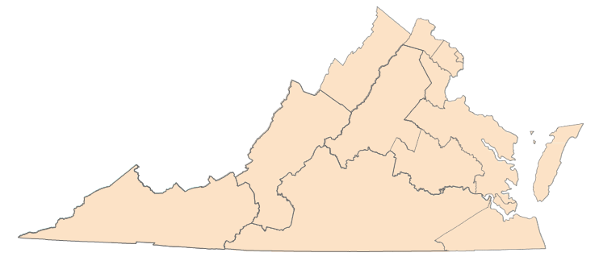
Guide to Regions of Virginia
Region 1 Alexandria City
Arlington
Region 2 Fairfax Fairfax City
Falls Church City
Region 5 Accomack | Region 8 Charles City | Region 10 Amelia | Patrick Petersburg City | Region 11 Bland | Region 12 Chesapeake City
Caroline | Chesterfield | Amherst | Pittsylvania | Bristol City | Franklin City
Essex | Goochland | Appomattox | Prince Edward | Buchanan | Isle of Wight
Gloucester | Hanover | Bedford | Prince George | Carroll | Norfolk City
James City | Henrico | Bedford City | Surrey | Dickenson | Portsmouth City
King and Queen | King William | Brunswick | Sussex | Floyd | Southampton
King George | New Kent | Buckingham |  | Galax City | Suffolk City
Lancaster | Powhatan | Campbell |  | Giles | Virginia Beach City
Mathews | Richmond City | Charlotte |  | Grayson
Middlesex |  | Colonial Heights City |  | Lee
Region 3 Fredericksburg City
Manassas City
Manassas Park City
Prince William
Stafford
Northampton
Northumberland
Poquoson City
Richmond
Spotsylvania
Westmoreland
Williamsburg City
York
Region 9
Alleghany
Augusta
Bath
Botetourt
Buena Vista City Covington City
Craig
Franklin
Highland Lexington City Roanoke
Roanoke City Rockbridge Salem City Staunton City
Waynesboro City
Cumberland
Danville City
Dinwiddie
Emporia City
Greensville
Halifax
Henry
Hopewell City
Lunenburg
Lynchburg City
Martinsville City
Mecklenburg
Nottoway
4
Montgomery
Norton City
Pulaski
Radford City
Russell
Scott
Smyth
Tazewell
Washington
Wise
Wythe
Region 13 Hampton City
Newport News City
Region 4
Clarke
Frederick Harrisonburg City Page Rockingham Shenandoah Warren Winchester City
Region 6
Loudoun
6
Region 7 Albemarle Charlottesville City Culpeper
Fauquier
Fluvanna
Greene
Louisa
Madison
Nelson
Orange
Rappahannock
2
3
1
7
5
9
8
11
10
13
12
for the Virginia Health Care Foundation

Slide 20
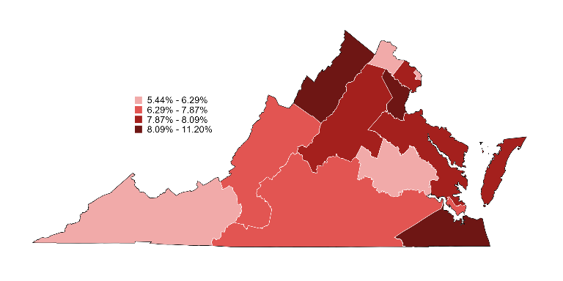
Map 1: Uninsured rate for all nonelderly (0-64)
Virginians in 2022, by region
Uninsurance Rate among Nonelderly
(VA Rate: 7.7%)
6
5.4%
2
8.0%
1
4
6.3%
10.1%
3
7
11.2%
5
9
8.1%
8.0%
7.3%
8
6.0%
11
10
13
5.8%
7.8%
12
7.9%
8.2%
Note: In 2022, the Census Bureau changed the Public Use Microdata Areas based on the 2020 Census. Regional estimates for 2022 are therefore not comparable to prior years.
Source: Urban Institute, March 2024. Based on the 2022 American Community Survey (ACS) data from the Integrated Public Use Microdata Series (IPUMS). For area definitions, see “Guide to Regions of Virginia”.
for the Virginia Health Care Foundation

Slide 21
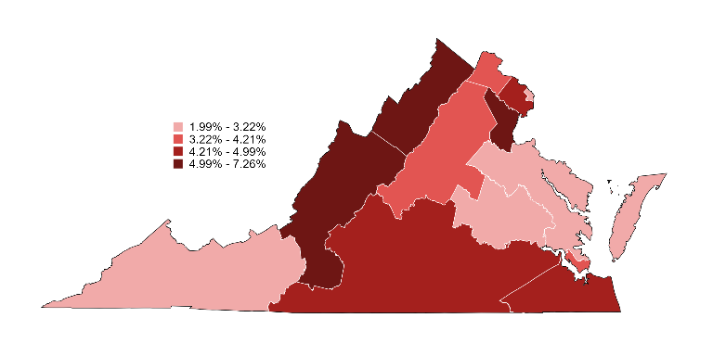
Map 2: Uninsured rate for all children (0-18)
in Virginia in 2022, by region
Uninsurance Rate among Children
(VA Rate: 4.5%)
6
3.7%
2
5.0%
1
4
2.0%
6.1%
3
7
7.3%
4.0%
5
9
3.2%
6.0%
8
2.9%
11
10
13
2.0%
4.8%
12
4.2%
4.8%
Note: In 2022, the Census Bureau changed the Public Use Microdata Areas based on the 2020 Census. Regional estimates for 2022 are therefore not comparable to prior years.
Source: Urban Institute, March 2024. Based on the 2022 American Community Survey (ACS) data from the Integrated Public Use Microdata Series (IPUMS). For area definitions, see “Guide to Regions of Virginia”.
for the Virginia Health Care Foundation

Slide 22
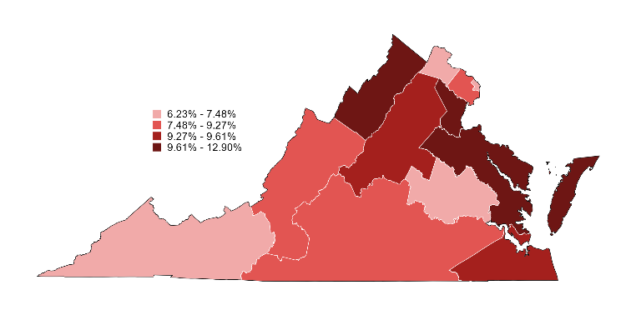
Map 3: Uninsured rate for all nonelderly adult (19-64)
Virginians in 2022, by region
Uninsurance Rate among nonelderly adults
(VA Rate: 9.0%)
6
6.2%
2
9.3%
1
4
7.5%
11.8%
3
7
12.9%
9.6%
5
9
9.9%
7.8%
8
7.2%
11
10
13
7.1%
9.0%
12
9.5%
9.6%
Note: In 2022, the Census Bureau changed the Public Use Microdata Areas based on the 2020 Census. Regional estimates for 2022 are therefore not comparable to prior years.
Source: Urban Institute, March 2024. Based on the 2022 American Community Survey (ACS) data from the Integrated Public Use Microdata Series (IPUMS). For area definitions, see “Guide to Regions of Virginia”.
for the Virginia Health Care Foundation

Slide 23
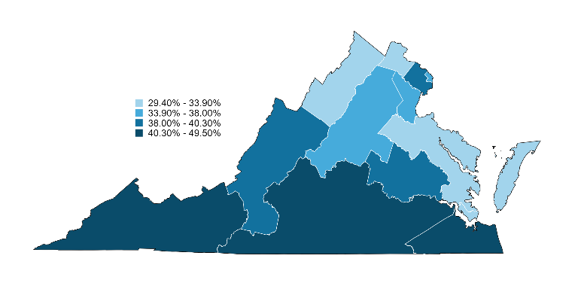
Map 4: Share of uninsured nonelderly adults (19-64) in Virginia with family income ≤138% FPL in 2022,
by region
6
Share of Uninsured
Adults ≤138% FPL
(VA Share: 38.7%)
29.4%
2
40.3%
1
4
35.7%
33.7%
3
7
38.0%
5
9
36.7%
31.6%
38.0%
8
38.5%
11
10
13
42.2%
49.5%
12
33.9%
41.2%
Note: In 2022, the Census Bureau changed the Public Use Microdata Areas based on the 2020 Census. Regional estimates for 2022 are therefore not comparable to prior years.
Source: Urban Institute, March 2024. Based on the 2022 American Community Survey (ACS) data from the Integrated Public Use Microdata Series (IPUMS). For area definitions, see “Guide to Regions of Virginia”.
for the Virginia Health Care Foundation

Slide 24
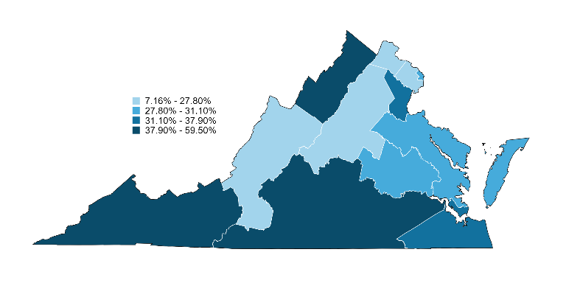
Map 5: Share of uninsured children (0-18) in Virginia with family income ≤205% FPL in 2022,
by region
6
Share of Uninsured
Children ≤205% FPL
(VA Share: 38.7%)
29.4%
2
40.3%
1
4
35.7%
33.7%
3
7
38.0%
5
9
36.7%
31.6%
38.0%
8
38.5%
11
10
13
42.2%
49.5%
12
33.9%
41.2%
Note: In 2022, the Census Bureau changed the Public Use Microdata Areas based on the 2020 Census. Regional estimates for 2022 are therefore not comparable to prior years.
Source: Urban Institute, March 2024. Based on the 2022 American Community Survey (ACS) data from the Integrated Public Use Microdata Series (IPUMS). For area definitions, see “Guide to Regions of Virginia”.
for the Virginia Health Care Foundation

Slide 25
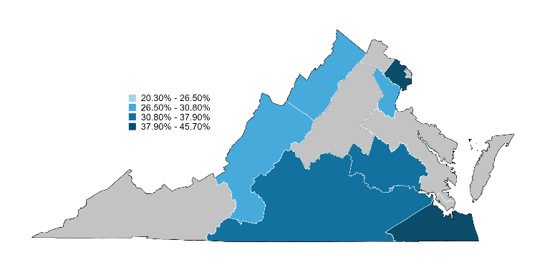
Map 6: Share of uninsured nonelderly adult
parents (19-64) in Virginia with family income
≤138% FPL in 2022, by region
6
Share of Uninsured
Parents ≤138% FPL
(VA Share 33.0%)
NA
2
39.5%
1
4
NA
29.0%
3
7
26.5%
9
NA
5
NA
30.8%
8
37.3%
11
10
13
NA
37.9%
12
NA
38.6%
Notes: Regions in gray have a sample size below 50 and have been suppressed. In 2022, the Census Bureau changed the Public Use Microdata Areas based on the 2020 Census. Regional estimates for 2022 are therefore not comparable to prior years.
Source: Urban Institute, March 2024. Based on the 2022 American Community Survey (ACS) data from the Integrated Public Use Microdata Series (IPUMS). For area definitions, see “Guide to Regions of Virginia”.
for the Virginia Health Care Foundation

Slide 26
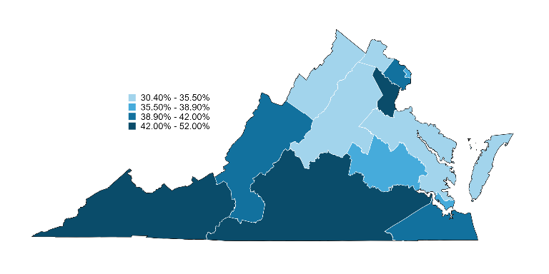
Map 7: Share of uninsured nonelderly childless
adults (19-64) in Virginia with family income
≤138% FPL in 2022, by region
6
Share of Uninsured Childless Adults ≤138% FPL
(VA Share 40.6%)
30.4%
2
40.6%
1
4
36.8%
35.5%
3
7
43.3%
5
9
34.8%
34.8%
41.7%
8
38.9%
11
10
13
44.9%
52.0%
12
38.0%
42.0%
Notes: In 2022, the Census Bureau changed the Public Use Microdata Areas based on the 2020 Census. Regional estimates for 2022 are therefore not comparable to prior years.
Source: Urban Institute, March 2024. Based on the 2022 American Community Survey (ACS) data from the Integrated Public Use Microdata Series (IPUMS). For area definitions, see “Guide to Regions of Virginia”.
for the Virginia Health Care Foundation

Slide 27
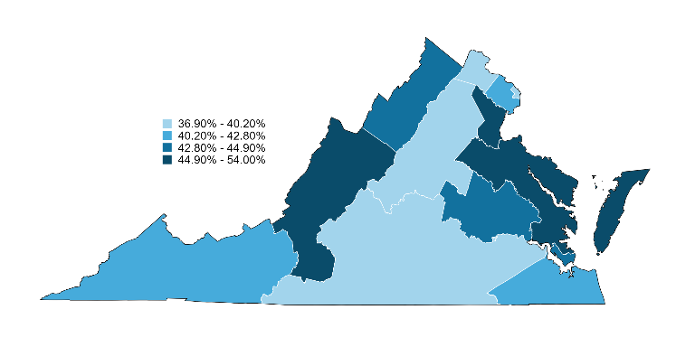
Map 8: Share of uninsured nonelderly adults (19-64) in Virginia with family income 139-400% FPL in 2022,
by region
6
Share of Uninsured Adults
139-400% FPL
(VA Share: 43.0%)
37.9%
2
41.1%
1
4
38.9%
43.8%
3
7
46.5%
40.2%
5
9
54.0%
48.6%
8
44.9%
11
10
13
42.8%
36.9%
12
42.8%
40.4%
Notes: In 2022, the Census Bureau changed the Public Use Microdata Areas based on the 2020 Census. Regional estimates for 2022 are therefore not comparable to prior years.
Source: Urban Institute, March 2024. Based on the 2022 American Community Survey (ACS) data from the Integrated Public Use Microdata Series (IPUMS). For area definitions, see “Guide to Regions of Virginia”.
for the Virginia Health Care Foundation

Slide 28
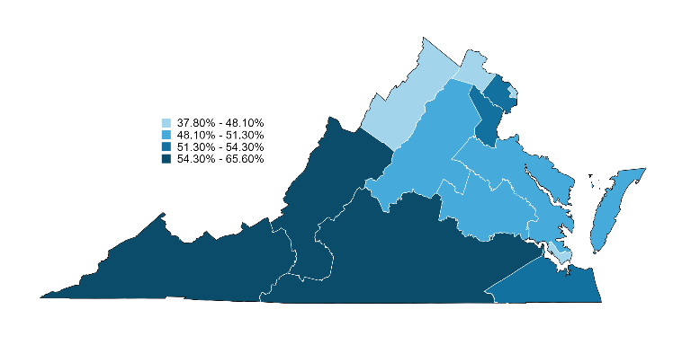
Map 9: Share of uninsured nonelderly adults (19-64) in Virginia with family income ≤200% FPL in 2022,
by region
6
Share of Uninsured
Adults ≤200% FPL
(VA Share: 52.5%)
37.8%
2
54.3%
1
4
42.7%
48.0%
3
7
52.5%
9
48.8%
5
51.3%
56.1%
8
51.1%
11
10
13
57.2%
65.6%
12
48.1%
52.7%
Notes: In 2022, the Census Bureau changed the Public Use Microdata Areas based on the 2020 Census. Regional estimates for 2022 are therefore not comparable to prior years.
Source: Urban Institute, March 2024. Based on the 2022 American Community Survey (ACS) data from the Integrated Public Use Microdata Series (IPUMS). For area definitions, see “Guide to Regions of Virginia”.
for the Virginia Health Care Foundation

Slide 29
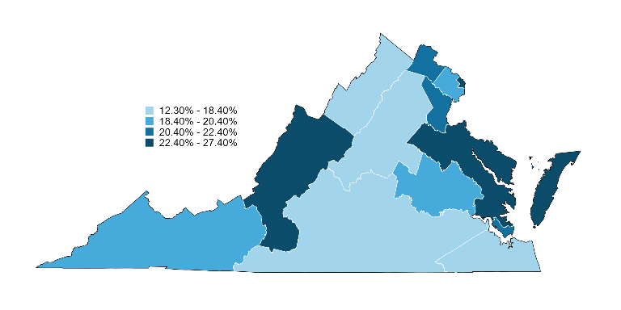
Map 10: Share of uninsured nonelderly adults (19-64) in Virginia with family income 251-400% FPL in 2022,
by region
6
Share of Uninsured Adults
251-400% FPL
(VA Share: 19.8%)
22.4%
2
20.0%
1
4
27.4%
17.6%
3
7
20.8%
9
18.4%
5
26.7%
24.4%
8
18.7%
11
10
13
20.4%
12.3%
12
21.4%
17.4%
Notes: In 2022, the Census Bureau changed the Public Use Microdata Areas based on the 2020 Census. Regional estimates for 2022 are therefore not comparable to prior years.
Source: Urban Institute, March 2024. Based on the 2022 American Community Survey (ACS) data from the Integrated Public Use Microdata Series (IPUMS). For area definitions, see “Guide to Regions of Virginia”.
for the Virginia Health Care Foundation

Slide 30
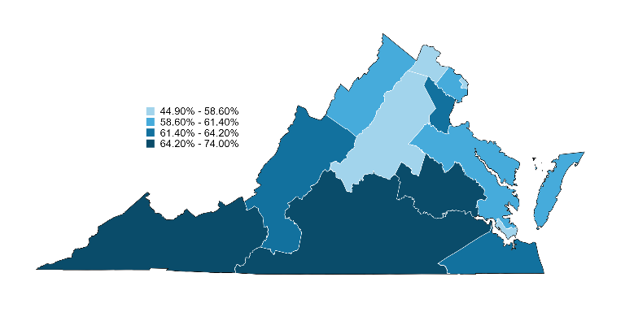
Map 10: Share of uninsured nonelderly adult (19-64) Virginians with family income ≤300% FPL in 2021, by region
6
Share of Uninsured
Nonelderly ≤300% FPL
(VA Share: 70.9%)
44.9%
2
65.7%
1
4
47.2%
59.8%
3
7
63.6%
58.6%
5
9
58.9%
62.2%
8
64.7%
11
10
13
64.5%
74.0%
12
55.4%
64.2%
Notes: In 2022, the Census Bureau changed the Public Use Microdata Areas based on the 2020 Census. Regional estimates for 2022 are therefore not comparable to prior years.
Source: Urban Institute, March 2024. Based on the 2022 American Community Survey (ACS) data from the Integrated Public Use Microdata Series (IPUMS). For area definitions, see “Guide to Regions of Virginia”.
for the Virginia Health Care Foundation

Slide 31
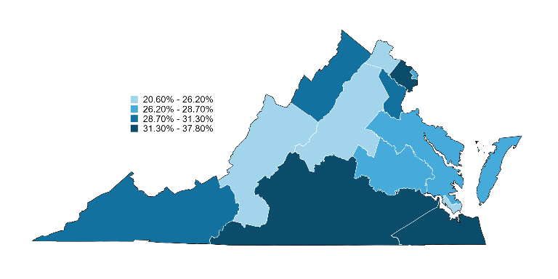
Map 11: Share of uninsured nonelderly (0-64) Virginians with family income ≤100% FPL in 2022, by region
6
Share of Uninsured
Nonelderly ≤100% FPL
(VA Share: 30.1%)
20.6%
2
34.9%
1
4
27.4%
29.3%
3
7
30.1%
24.0%
5
9
27.4%
22.7%
8
28.7%
11
10
13
31.3%
37.8%
12
26.2%
31.7%
Notes: In 2022, the Census Bureau changed the Public Use Microdata Areas based on the 2020 Census. Regional estimates for 2022 are therefore not comparable to prior years.
Source: Urban Institute, March 2024. Based on the 2022 American Community Survey (ACS) data from the Integrated Public Use Microdata Series (IPUMS). For area definitions, see “Guide to Regions of Virginia”.
for the Virginia Health Care Foundation

