Slide 1

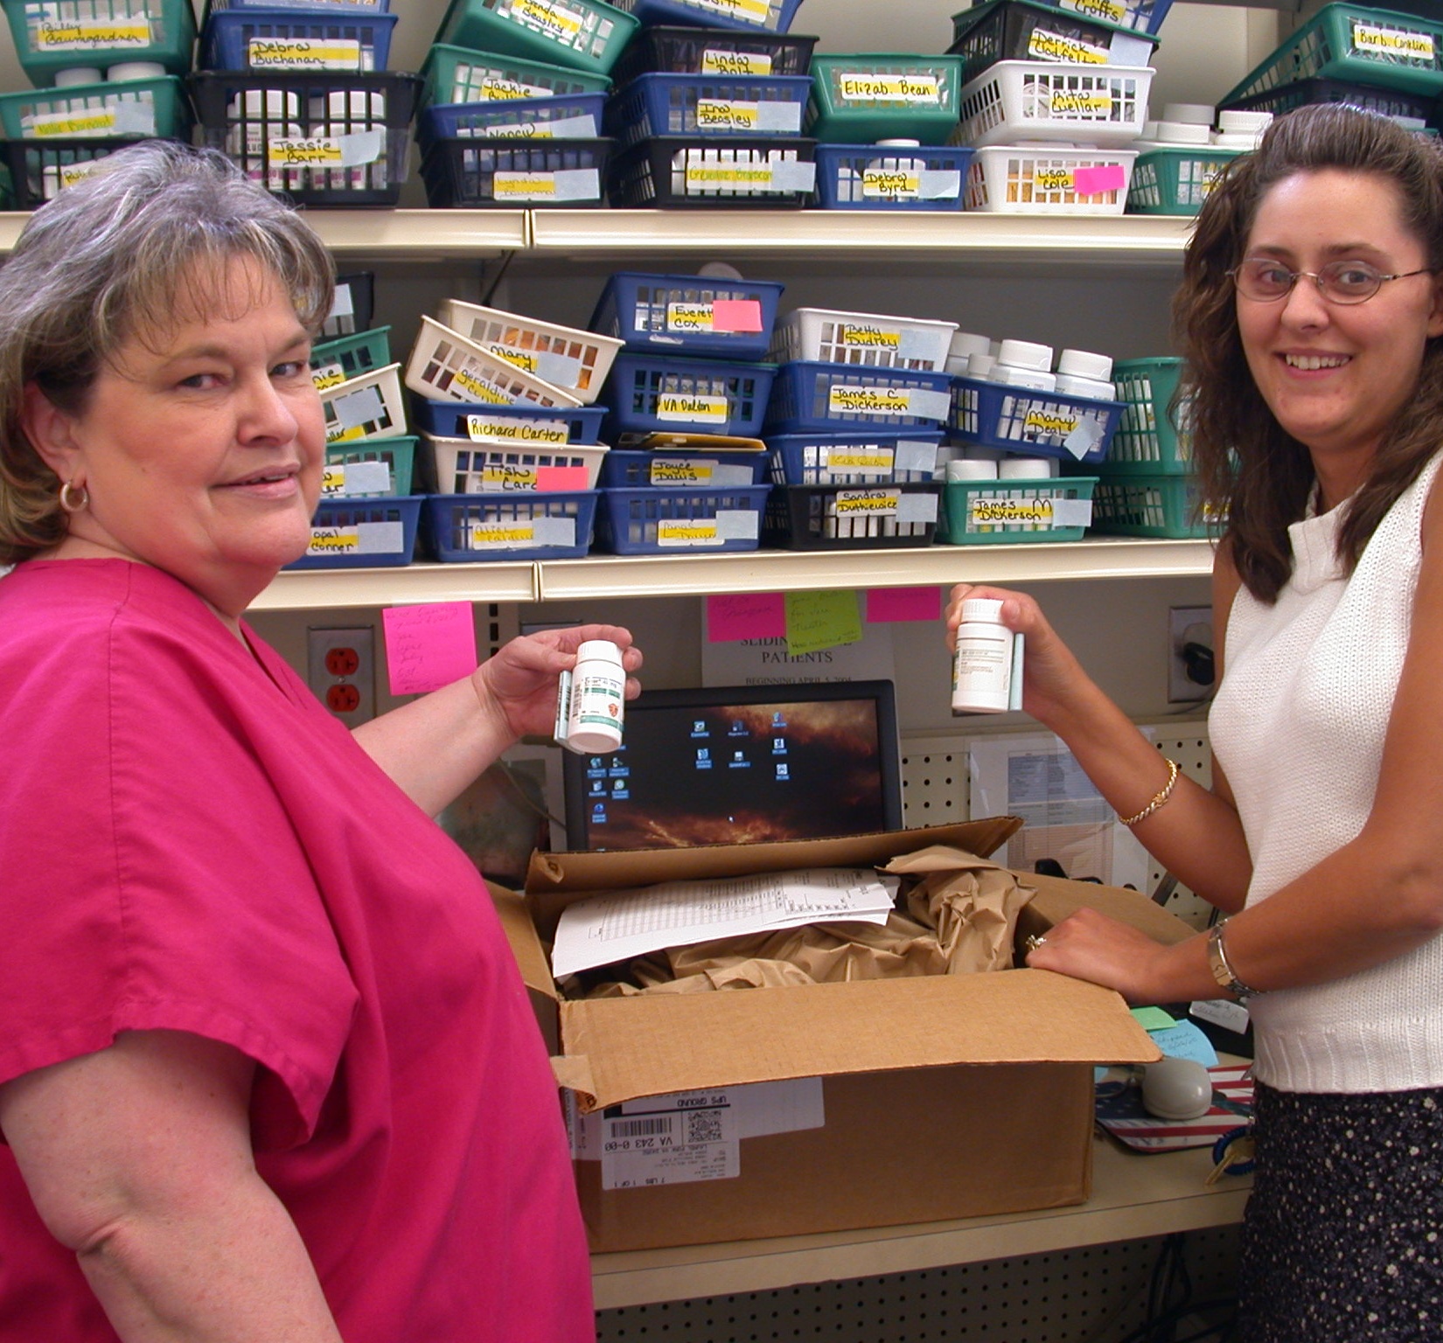

How to start a Medication Assistance Program (MAP)
Brought to by
  Tri-Area Community Health MAP
  The Pharmacy Connection (TPC)

Slide 2
Funding & Sustainability
Develop a Budget
Determine the total cost of the program
Plan for how the MAP will be sustained in the future
Apply for grants

Slide 3
Resources
Adequate office space
A dedicated phone line with voicemail
Access to fax and copier *very important!
Computer with an internet connection to access TPC
Advertising materials
Other miscellaneous office supplies

Slide 4

Staffing
VHCF offers
  Job descriptions
  Training webinars
    Beginners
    Advance
  Personalized training
  Semi-Annual Roundtables
  Monthly TPC monthly technical assistance calls
    Networking opportunities with other TPC users

Slide 5
Managing a Medication Assistance Program
Locations of MAP
Physician office
Clinic
Hospital
Pharmacy
Partners
Contract pharmacy
Local Physician offices
Marketing
Materials to providers and patients

Slide 6
Managing a Medication Assistance Program
Communication
Tracking
Medication Orders
Deliveries
Pharmacies
Patient
Providers
Patient Assistance Programs
Patient Pick-ups
Physicians Offices

Slide 7

Marketing a MAP to Physicians
Meet with Leadership to discuss staff marketing and new staff onboarding
Join provider meetings
    Discuss current medications available in TPC
    General patient eligibility criteria
    Group medications by classifications
    Time frames of medication delivery
    MAP office contact information and referral process
Meet with new providers during the first few months of employment

Slide 8

Marketing A map to patients
Meet with Leadership to discuss updating the marketing campaign
  Include patient qualifying information
    Income guidelines
    List of the most requested medications
    MAP department contact information
  Marketing Placement
  How to identify patients in need of medication assistance

Slide 9

MAP Outreach
Market to organizations in the community
  Social Services Agencies
  Health Departments
  Food Banks
  Community Service Boards
  Faith Based organizations

Slide 10
Evaluate and improvement
Reports
* Run monthly TPC reports
* Provide quarterly
physician reports
Evaluate
* Survey patients on their experience with MAP
Additional resources
* Apply for additional
grants and funding

