Slide 1
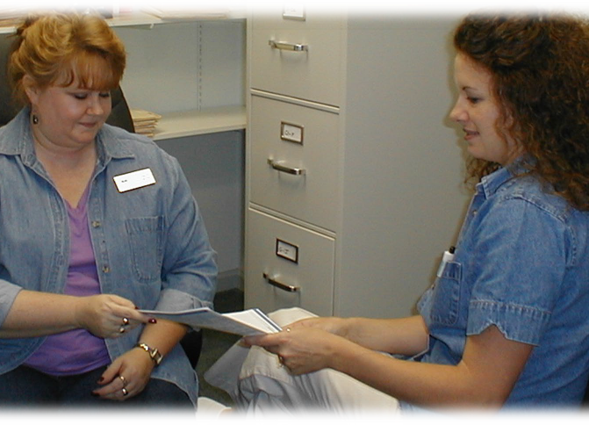

A Medication Assistance Program
Medication Assistance Caseworkers (MACs) help patients enroll in Prescription Assistance Programs (PAP) via The Pharmacy Connection Software (TPC).

Slide 2

Screening Process
Patient provides
Patient completes an intake form and/or PAP application with MAC assistance
Tax return or signed 4506T form
1 month’s pay stubs
Copy of unemployment benefits, pension, or Social Security statement
Physician provides
Patients' medication list
Income documentation
Signed prescription

Slide 3

Working with the Physician
The Medication Assistance Caseworker (MAC) works closely with the physician’s office
  MAC and patient complete the PAP application via TPC
  Physician signs the application
  PAP application sent to the pharmaceutical company
    MAC or Physician submits/faxes/mails the PAP application

Slide 4
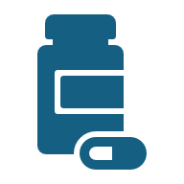
Medication Arrival
Medication arrivals
Up to 6 weeks
At the doctor’s office, clinic, hospital
Some are mailed directly to the patient’s home
Medication dispensing
Partner pharmacy may receive and dispense medication to patients

Slide 5

Bridge Medications
Bridge medication may fill the lag time
  Samples
    Dispensed at clinic or physician’s office
  Generic medication
    May be prescribed for interim use
  Vouchers
    May be used to pay for medications until the free PAP medication arrives

Slide 6
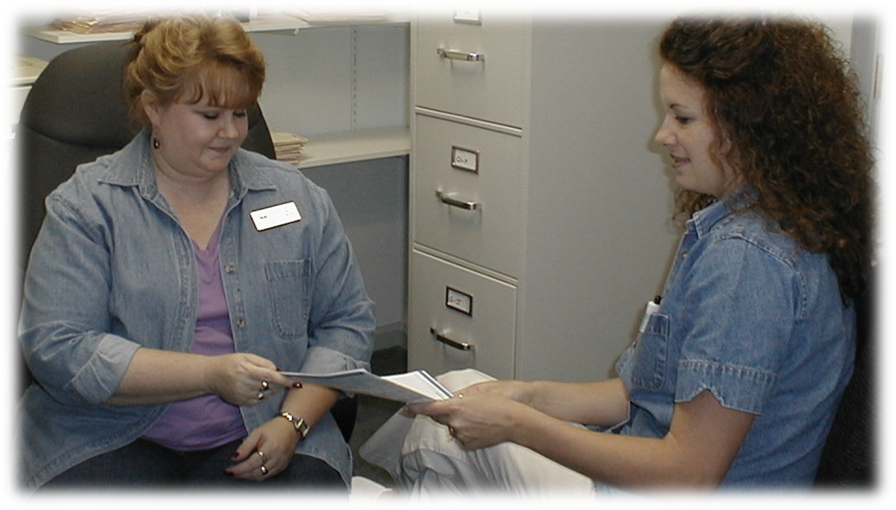
Refills and Renewals
Refills
Refills requests are automatically queued by TPC every 90 days
MAC processes the refill through the PAP or pharmacy
MACs call to inform patients/providers that medication will be delivered directly to the home/office
Patients/providers can call to notify MAC when they receive medications delivered directly to their home/office
Yearly renewals required

