Slide 1
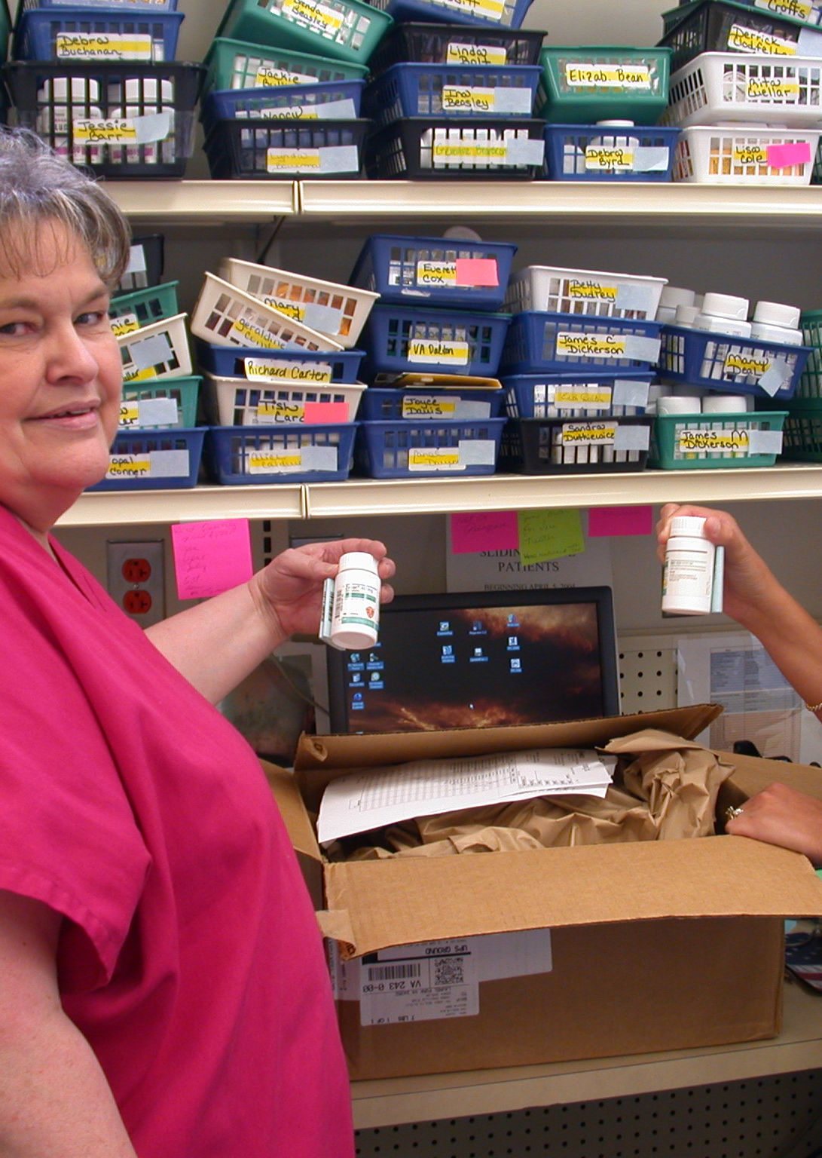


How to start a Medication Assistance Program (MAP)
Brought to by
Tri-Area Community Health MAP
The Pharmacy Connection (TPC)

Slide 2

Funding & Sustainability
Develop a Budget
Determine the total cost of the program
Plan for how the MAP will be sustained in the future
Apply for grants

Slide 3
Resources
Adequate office space
A dedicated phone line with voicemail
Access to fax and copier *very important!
Computer with an internet connection to access TPC
Advertising materials
Other miscellaneous office supplies

Slide 4

Staffing
VHCF offers
Job descriptions
Training webinars
Beginners
Advance
Personalized training
Semi-Annual Roundtables
Monthly TPC technical assistance calls
Networking opportunities with other TPC users

Slide 5
Managing a Medication Assistance Program
Locations of MAP
Physician office
Clinic
Hospital
Pharmacy
Partners
Contract pharmacy
Local Physician offices
Marketing
Materials to providers and patients

Slide 6
Managing a Medication Assistance Program
Communication
Tracking
Medication Orders
Deliveries
Pharmacies
Patient
Providers
Patient Assistance Programs
Patient Pick-ups
Physicians Offices

Slide 7

Marketing a MAP to Physicians
Meet with Leadership to discuss staff marketing and new staff onboarding
Join provider meetings
Discuss current medications available in TPC
General patient eligibility criteria
Group medications by classifications
Time frames of medication delivery
MAP office contact information and referral process
Meet with new providers during the first few months of employment

Slide 8

Marketing A map to patients
Meet with Leadership to discuss updating the marketing campaign
Include patient qualifying information
Income guidelines
List of the most requested medications
MAP department contact information
Marketing Placement
How to identify patients in need of medication assistance

Slide 9

MAP Outreach
Market to organizations in the community
Social Services Agencies
Health Departments
Food Banks
Community Service Boards
Faith-based organizations

Slide 10
Evaluate and improvement
Reports
* Run monthly TPC reports
* Provide quarterly
physician reports
Evaluate
* Survey patients on their experience with MAP
Additional resources
* Apply for additional
grants and funding

